Slide 1
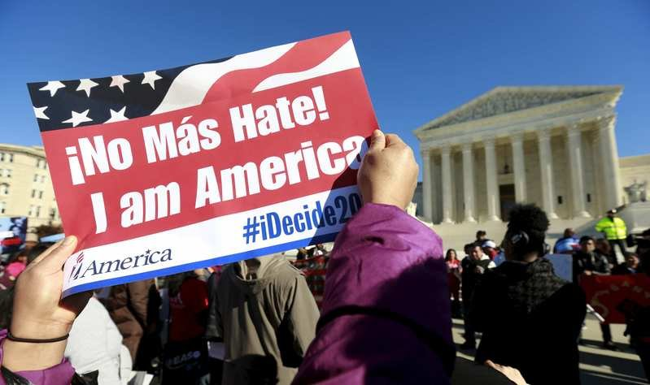
Equal Rights For Immigrants
By: Gaby Jaracuaro
Professor Ramos
English 101
July 5, 2017

Slide 2
Thesis
Why do the Immigrants migrate to the US? Immigrants come to the U.S for better opportunities like: healthcare, more jobs, money wise and better future for their kids. According to the website,”Imagine living in a country with limited access to healthcare when you’re at a serious health problem” (globalcitizen.org). The society see’s that immigrants are getting treated differently and that they are not getting equal rights like everybody else.

Slide 3
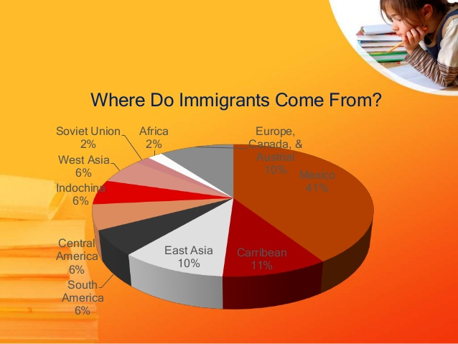
Where do Immigrants come from?
The U.S experienced a major wave of immigrants in the first part of the 19th century
In 1965, congress passed the Immigration and Nationality Act, which did away with quotas (limited people) based on nationality and allowed Americans to sponsor relatives from their countries of origin
People from different places like Germany, Russia, Africa, China, and Mexico seek for better things
Immigrants migrate to the U.S because most are treated like slaves, criminals, and blackmaled
Majority of immigrants are Mexicans

Slide 4
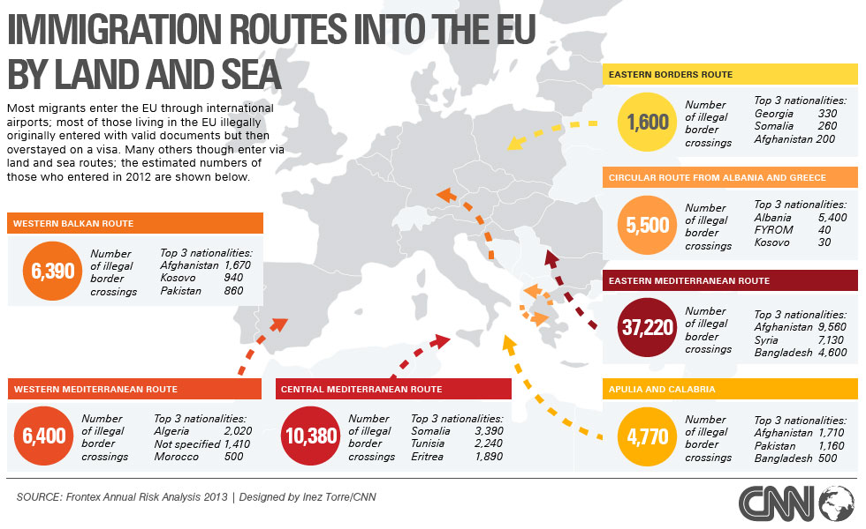
Different routes
Some cross the seas, river, and land
others cross the border by car, trucks, and trains
There’s a train that is Called “La Bestia” which kills people when they get off or they get killed by gang members
The people that cross with ships or boats die by hunger and diseases
The people that hide in the truck they get dehydrated
Video :https://www.youtube.com/watch?v=6owtt5NzW6g

Slide 5
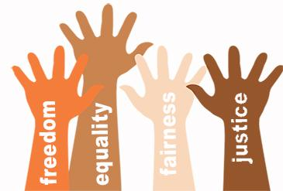
Racism
52% get discriminated by ethnicity
Skin color or the clothes people wear
Religion
Some get deported by not knowing english
Some get treated different because they got a different I/D like the one Mexicans have “Consular Identification Card”
For example, when people start talking in their language others think they are talking about them
People don’t like their kids hanging out with others that are not there race.

Slide 6
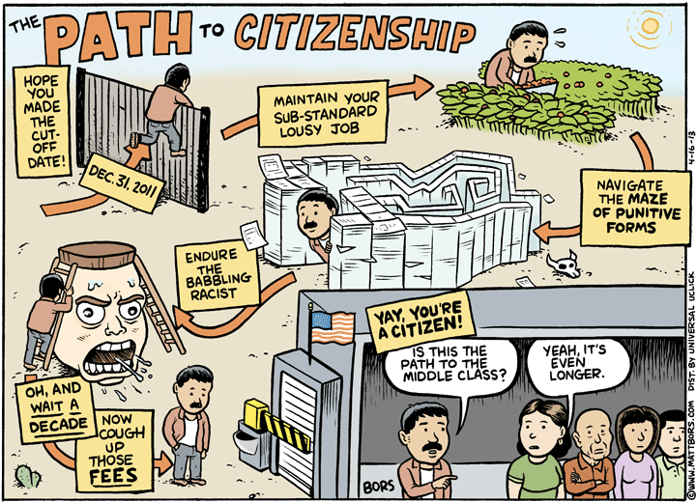
Benefits
Immigrants are allow to apply to welfare
For a Driver License, which the law recently got pass in January 2015
Also they could get healthcare but only if they have low income
Rent a house for there kids
Do taxes
Open a bank account under there name
Send their kids to school
Get a labor job

Slide 7
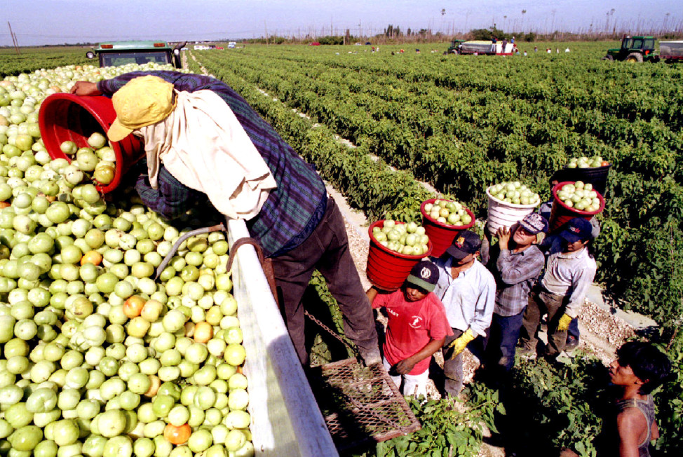
Jobs
Immigrants work at a field breaking their backs day and night
They don’t care if it’s raining, burning, or even if there’s a thunder, they care about providing money for their family
For example, my stepdad is a tree trimmer and he has to work in this heat just to provide us and to keep this roof under our heads
Some jobs are really heavy that they get injured and they are scared to sue them
Some Immigrants don’t know that they have the rights to take days off

Slide 8
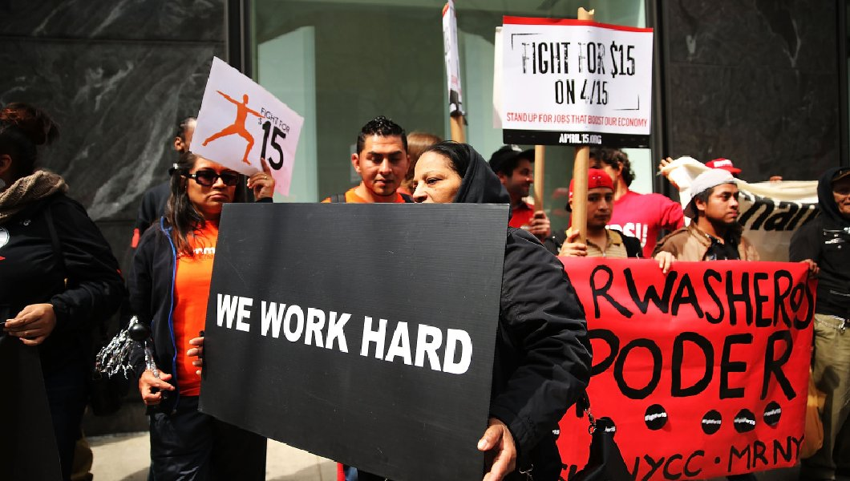
Wages
Cesar Chavez stood up for people to get paid more
Immigrants do hard labor and earning the minimum wage but they should be getting more
Some companies think that they could take advantage of paying them less but they know that they should deserve to get a raise
There’s immigrants that get paid less because they can’t prove that they are allow to work in the U.S or get hired to get paid more

Slide 9
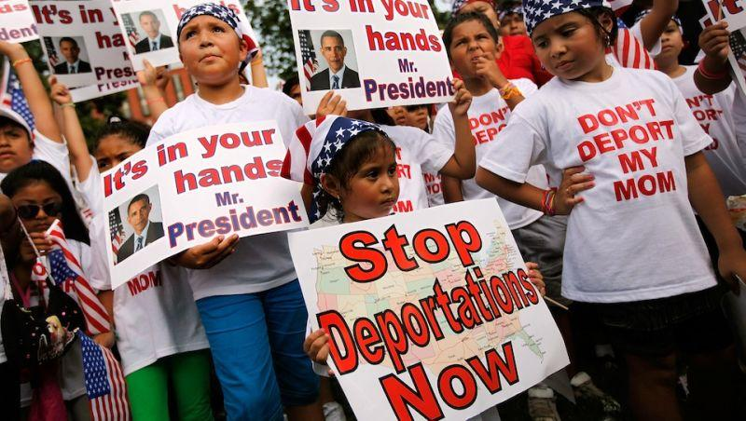
Personal Interview
I Interviewed my Mom, which her name is Guillermina. She has 11 siblings and second oldest in the family. She is an Immigrant and she migrated here in the U.S when she was 16 years old. She came to the U.S for a better future and because where she use to live there was no food nor money. Now that she is here in the U.S it’s pretty hard for her to get a job. Although, she thought that the world in the U.S was easier but it’s not. She said “El Norte”, is just pure B.S. because all the money goes to the government and paying bills here and there. Lastly, she said, that its nice that we have all this parks and beaches that I could take my family.

Slide 10
My Opinion
What I think about this is that Illegal Immigrants should get their citizens because they come to the U.S for more opportunities. They don’t come here to harm people or to take away jobs. I think they deserve an opportunity to stay here in the U.S and get equal rights like all of us. People should discriminate just because immigrants can’t speak english or there skin color. All of us like to judge but why can’t we just stop for a minute and think about them and if they got treated differently at there own country. I come with family that are immigrants and I don’t treat them different because they are my family, and i honestly don’t care if I’m a citizen here I still love my family.
Immigrants should deserve more than respect because they help us with picking fruit and vegetables. However, they work in the heat and when its raining to have food. The government and the politicians should see that illegal immigrants are not bad people.

Slide 11
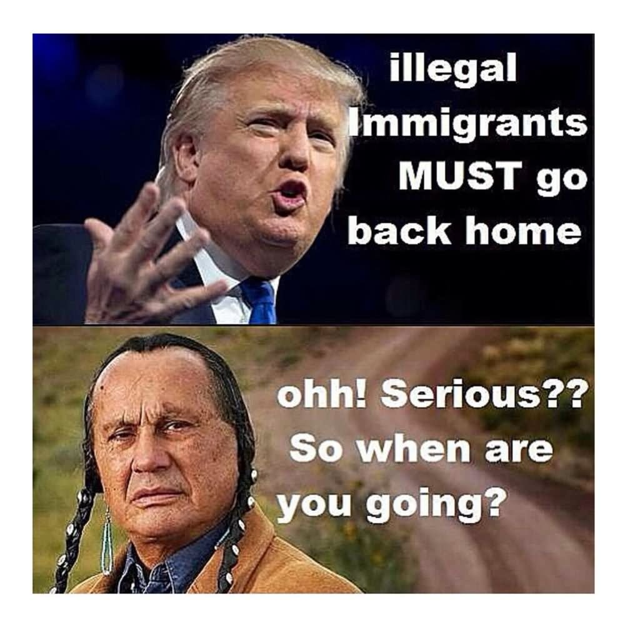
Disagree
President Trump disagree with giving immigrants there U.S citizenship because he think that they are here to take people’s jobs and that they are criminals
Republicans agree with Trump argument and they were against with giving illegal immigrants there Driver's Licenses
There’s this man his name is Joseph Turner wants that illegal students not to attend public schools in the Inland Empire and from grades k-12. Also he wants parents to pay for there tuition. This happen here in Yucaipa close to Calimesa Ca

Slide 12
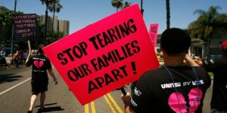
Agree
Some democrats agree that immigrants should have some kind of legal rights and DL
The whole society stands for a lot of people that get discriminated
Even famous artist stand up for illegal immigrants to have equal right
Teachers also agree that Illegal students should have the right to go college
Lawyers have fought many cases that many families been split because they got deported

Slide 13
Work Cited
.www.econofact.org
www.dmv.org/ca-california/ab-60-drivers-license.php
www.globalcitizen.org
www.history.com
http://www.latimes.com/local/lanow/la-me-ln-undocumented-children-initiative-20170405-story
www.migrationpolicy.org/article/central-american-migrants-and-%E2%80%9Cla-bestia%E2%80%9D-route-dangers-and-government-responses
www.pewresearch.org
www.politifact.com/texas/statements/2016/sep/28/tom-delay/tom-delay-says-most-illegal-immigrants-draw-welfare

