Slide 1
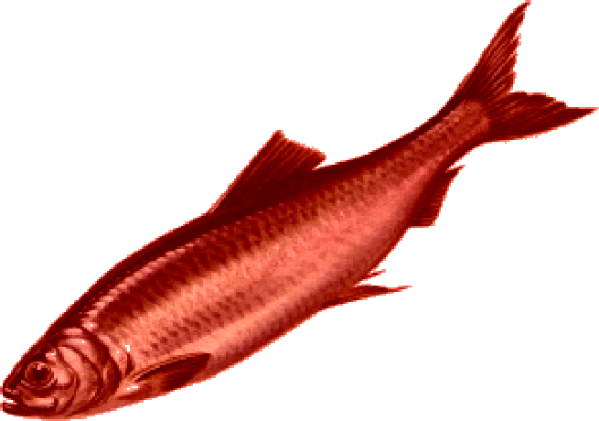
Red Herring
Jacob Bernardo
Engl.101
Professor Ramos

Slide 2
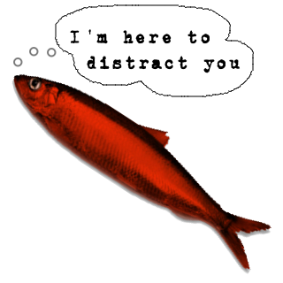
What is a Red herring
Well a red Herring is a lightly salted and smoked till brown fish.
Lmao you just got Red herring’d ya dingus!
A red herring is really something that misleads or distracts from a relevant or important issue.
Not to be confused with straw man or (straw figure)

Slide 3
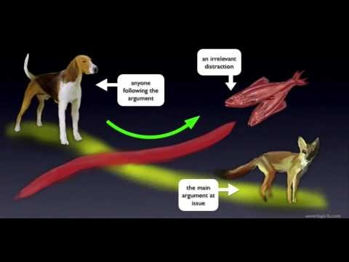

Slide 4
Some stellar examples
Like when you wanted a toy when you were little but your mom distracted you and said that she had them waiting at home.
Or
“I know I’ve made a mistake. But think of my parents. They’re going to kill me”.

Slide 5
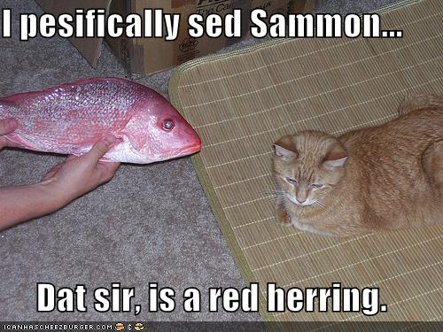
How to avoid it a red herring
You can avoid a red herring simply by sticking to your topic and not trying to change the subject of the issue at hand.
You could also avoid argument or talking to people all together like who needs to talk when you could just be distract by what im typing in this power point and waste your time very easily.

Slide 6
Work Cited
Fish number one: https://rpgathenaeum.files.wordpress.com/2009/04/redherring.png
Fish number two: http://api.ning.com/files/E9fEOxuVMyQ0EfYADLQIxBk47eZHFK1WeTOEC*y4hOxHznwvYr1NI9oIJoChJM5K*Lx96KpA3q-GYjhkLNm9f8U2XQ*mqjTn/redherring.png
Kitty n Fish me me : https://ladyfi.files.wordpress.com/2009/04/red_herring1.jpg
https://literarydevices.net/red-herring/

