Slide 1
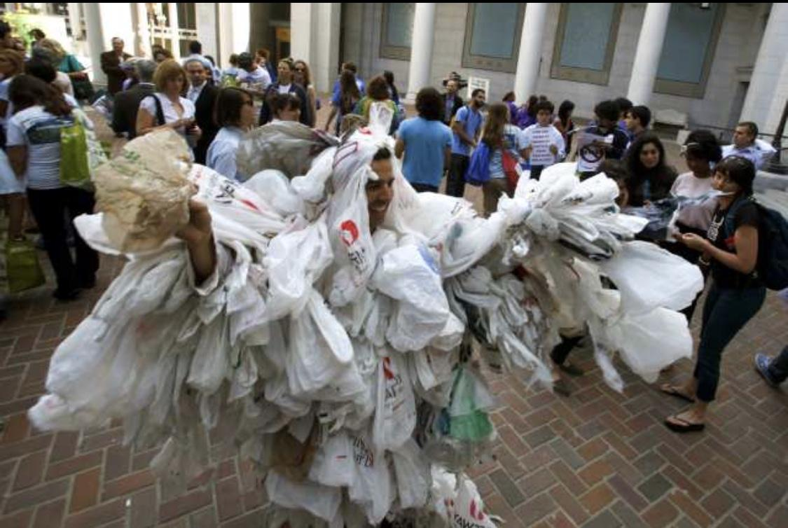
Plastic Gone Forever?
Aryanna Bentley
Monday 3:00pm

Slide 2
Plastic Vs.Reuseable Cost
Reuseable
Many supermarkets encourage the use of reusable shopping bags to increase sales and profit margins. Most non woven bags cost $0.10-0.25 to produce but are sold for $0.99-$3.00.
Many major retailers sell reusable bags in biodegradable canvas, plastic or “bioplastics” manufactured from natural materials..
Plastic
A standard plastic grocery bag costs about a penny to produce, compared with 4 cents to 5 cents for a paper bag.
On average we only recycle one plastic bag in every 200 we use. Each year, an estimated 500 billion to 1 trillion plastic bags are consumed worldwide. That comes out to over one million per minute.

Slide 3
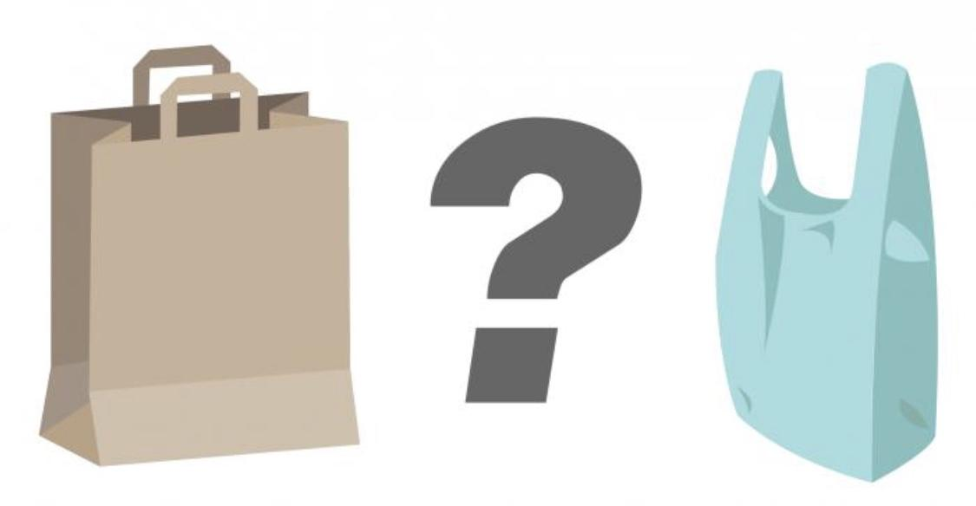
Plastic Vs. Reuseable
Americans use over 100 billion of these bags a year, and each bag is typically used for an average of just over 10 minutes. However, once a bag is discarded, it can take up to 1,000 years to really disappear. And while they’re sticking around, they cause all kinds of environmental problems.
They are often made of cotton, which needs a lot of land for harvesting, and they require lots of resources to produce. However, as long as they are used as often as possible, over time they can leave a less harmful footprint than single use plastic bags.

Slide 4
Plastic
Pros
-They are durable and can be used more than once
-They take up less space in a landfill than paper bags It takes 91% less energy to recycle a pound of plastic than it takes to recycle a pound of paper.(Recycling rates of either type of disposable bag are extremely low, with rates of 10-15% for paper and 1-3% for plastic.)
Cons
-500 billion to 1 trillion plastic bags are used every -year, worldwide
-About 1 million plastic bags are used every minute.
-A single plastic bag can take 20 to 1,000 years to degrade
-The U.S. goes through 100 billion single-use plastic bags. This costs retailers about $4 billion a year
-Plastic bags remain toxic even after they break down

Slide 5
Non-Plastic
Pros
-Where do plastic garbage bags go? The trash. That means there are millions in landfills right now. Reusable grocery bags can be used multiple times and many of them are made from biodegradable materials.
-At the heart of plastic creation is the use of petroleum, refined from fossil fuels. More reusable bags means fewer fossil fuels used to carry things.
Cons
-The average cost of a plastic bag is about $0.01. It may cost $1-$2 for a reusable grocery bag.
-Reusable bags are great for produce and boxed items. They aren’t so good for canned goods and heavier items.
-Reusable bags aren’t always made from biodegradable materials. This means one plastic gets traded for another.

Slide 6
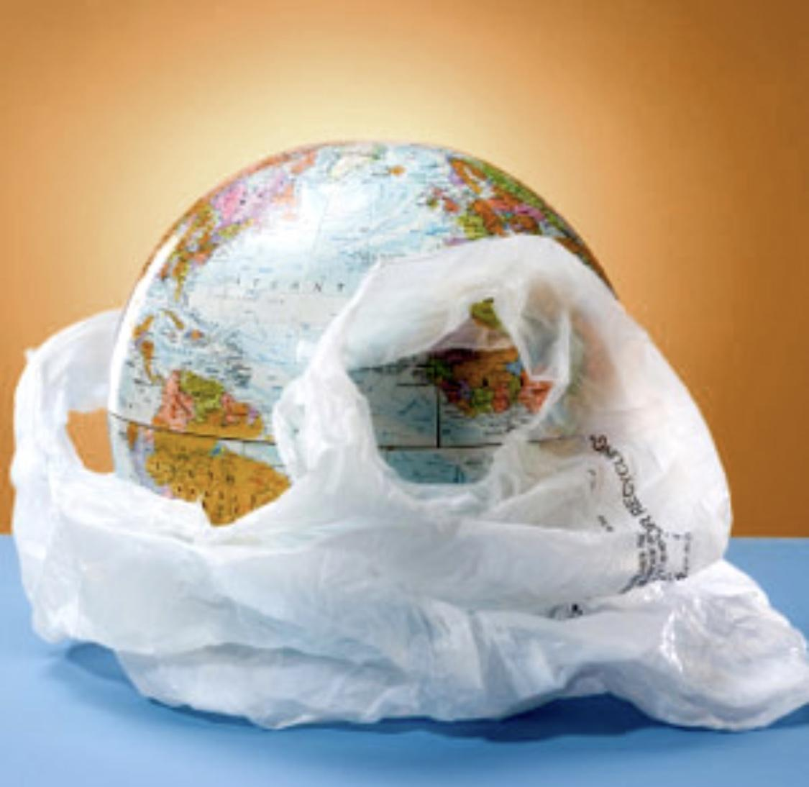
The
Honest Truth
Why is it that the reason to band single use bags is to help a nation but not all states are doing it . Some states put a tax or fee on them.
While others are still allowed to get them freely.
Why is it that low income house holds still get them in large quantities free each time is this not promoting a whole nation to work together.
Out of our 50 states 12 of them have decided to make a difference while the other choose not too .

Slide 7
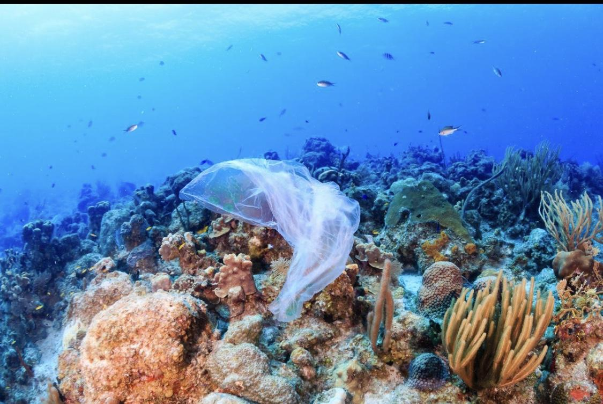
The Impact
Plastic
Plastic bags find there way into our oceans and kill over 1,000,000 or more sea life each year !
They also take over 1000 years to disintegrate that is on land in the ocean it takes about 20 years for a bag 450 for a bottle and 600 years for fishing line
Reuseable
These bags are made mostly from recycled materials and are easy to rewash and reuse
They are more heavy duty and easier to take along with u rather than the single use that fall apart before u can get to the car

Slide 8
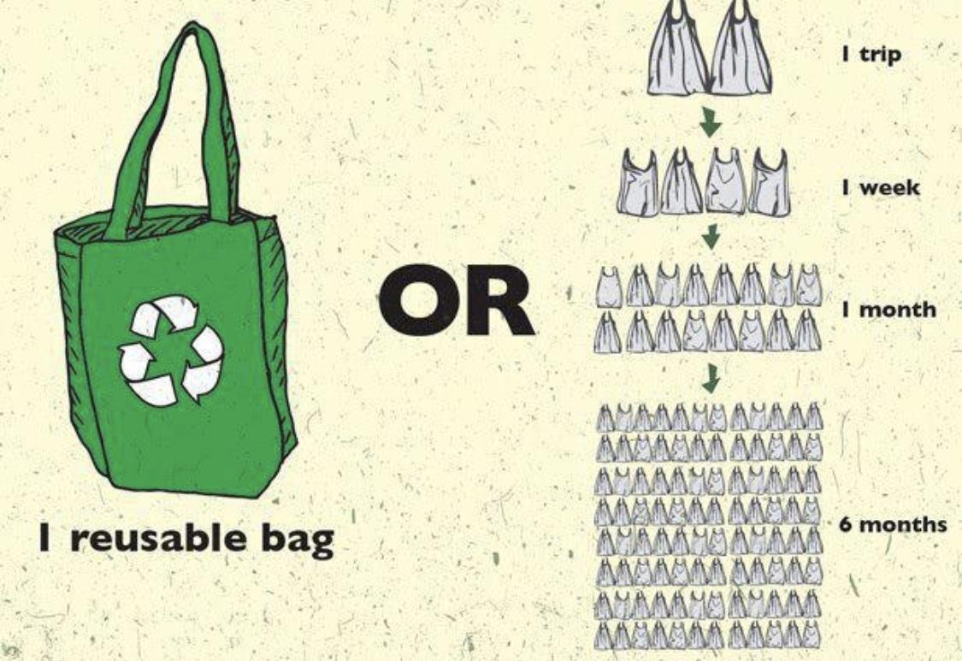
In Conclusion
The choice is your but the functionality of reuseable bags and the more environmentally friendly sense I concluded that reuseable bags are the way to go .

Slide 9
Citations
Brook, Benedict. “Think Plastic Bags Are Bad? You Should See How Not Green the Alternatives Are.” NewsComAu, News.com.au, 20 June 2018, amp.news.com.au/technology/environment/climate-change/plastic-bag-ban-many-alternatives-have-huge-environmental-footprints/news-story/2ea67901345f07b6515bcb71e20c708f
.“It's Been a Year since California Banned Single-Use Plastic Bags. The World Didn't End.” Los Angeles Times, Los Angeles Times, 18 Nov. 2017, www.latimes.com/opinion/editorials/la-ed-plastic-bag-ban-anniversary-20171118-story.html?outputType=amp
Potenza, Alessandra. “Are Cotton Totes Better for the Earth than Plastic Bags? It Depends on What You Care About.” The Verge, The Verge, 12 May 2018, www.theverge.com/platform/amp/2018/5/12/17337602/plastic-tote-bags-climate-change-litter-life-cycle-assessments-environment.

Slide 10
Citations
“Single-Use Shopping Bags Could Soon Cost You in Jersey | Video.” NJTV News, 9 July 2018, www.njtvonline.org/news/video/single-use-shopping-bags-could-soon-cost-you-in-jersey
“The Case of the Plastic Bag Tax: Why Don't We All Carry That Weight?” Tax Policy Center, 4 Apr. 2018, www.taxpolicycenter.org/taxvox/case-plastic-bag-tax-why-dont-we-all-carry-weight.

