Slide 1
Parent Mental Illness
Leeana Demchesen
English 010
Professor Ramos

Slide 2
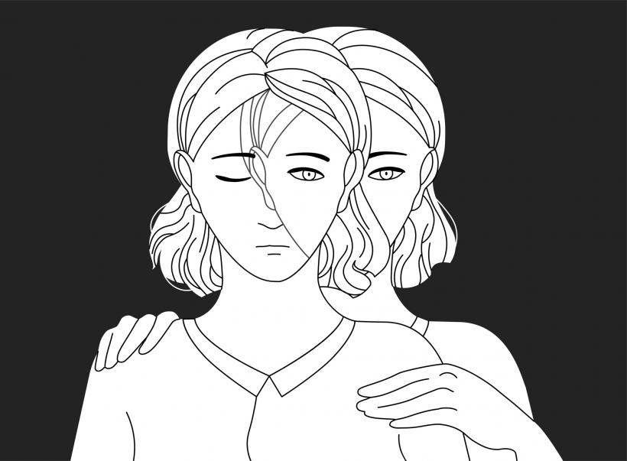
What Is Mental Illness?
Mental illness is when a person to some degree loses control of their thoughts, feelings or behavior and is estimated to affect 1 in 4 people.
Sometimes starts off mild such as depression but can also lead to the extreme of schizophrenia.
Each person will have the same diagnosis but different experiences.

Slide 3
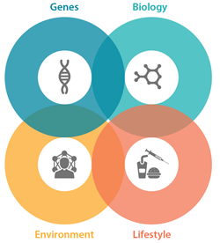
What Causes Mental Illness?
Former or current drug use
Heredity
Personal experience that occurred earlier in life
Personal losses
Chemical Imbalance
Genes
Lifestyle
Head Trauma

Slide 4
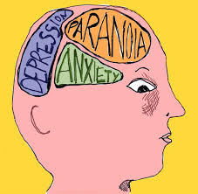
What Are Some Forms of Mental Illnesses?
Clinical Depression
Bipolar Disorder
Dementia
Schizophrenia
Obsessive Compulsive Disorder
Autism
Post Traumatic Disorder
Personality Disorder

Slide 5

Impact On Child
“Parenting is both greatly rewarding demoting task for anyone, but it passes some particular challenges for people with a mental condition.”
Parents illness can cause stress to the child and can cause detachment from the parent.
The affect on children poses as biological, psychological, and environmental.
Children are not all affected in the same way negatively.
Mental Illness is not contagious but may have a genetic link to parent.

Slide 6
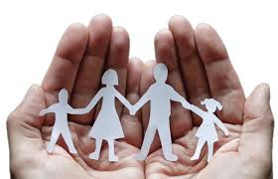
Impact On Parent
The fact that the parent has a Mental Disorder is not enough to cause problems but rather how their behavior affects the child and family.
Can affect the ability to parent
Not mentally available
Overly emotional
Verbal or physical abuse
Cause stress to self and child

Slide 7
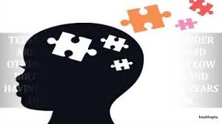
Children Risk Factors
Anger
Fear
Guilt
Shame
Anxiety
Sadness
Depression
Trust Issues
Social Anxiety

Slide 8
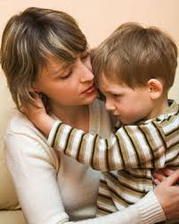
How To Communicate With Child
Parents often want to appear strong to their children causing them to want to hide their mental illness but as children get older they are more knowledgeable about surroundings and can tell if something is being hidden from them.
Depends on age and the maturity of the child if they will understand.
Some children will be supportive and remind you when medication needs to be taken.

Slide 9
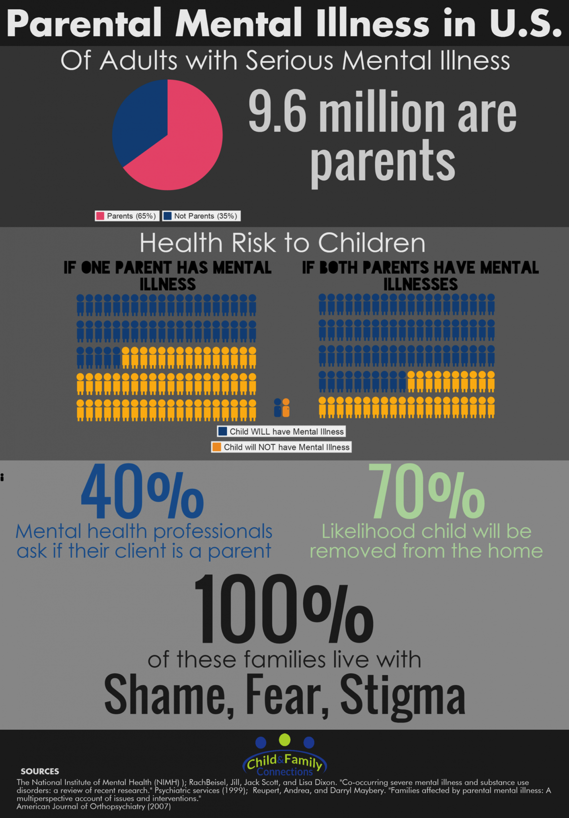
Statistics of Mental Illness
Up to one in five children live with a parent who has a mental illness.
A UK national survey reported that about 10% of women and 6% of men with a mental illness were parents.

Slide 10
Sources
Joanne Nicholson, Elaine Sweeny, and Jeffrey Geller. Mothers With Mental Illness: I The Competing Demands of Parenting and Living With Mental Illness. Psychiatric Services. May 1998 Vol. 49. No 5
Gopfert, M., Webster, J & Sherman, M. 2nd edition (eds) (2004) ‘Parental Psychiatric Disorder’- Distressed Parents and Their Families. Cambridge: Cambridge University Press
Ballal, Divya, and Janardhana Navaneetham. “Talking to Children about Parental Mental Illness: The Experiences of Well Parents.” International Journal of Social Psychiatry, vol. 64, no. 4, June 2018, pp. 367–373. EBSCOhost, doi:10.1177/0020764018763687.
Wilson, Peter. “Out of the Mainstream: Helping the Children of Parents with a Mental Illness.” British Journal of Psychotherapy, vol. 30, no. 1, Feb. 2014, pp. 126–129. EBSCOhost, doi:10.1111/bjp.12068.
Kuppin, Sara, and Richard M. Carpiano. “Public Conceptions of Serious Mental Illness and Substance Abuse, Their Causes and Treatments: Findings from the 1996 General Social Survey.” American Journal of Public Health, vol. 98, Sept. 2008, pp. S120–S125. EBSCOhost, doi:10.2105/AJPH.2004.060855.

