Slide 1
Frozen
A Music Video Review

Slide 2
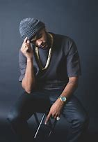
Joyner Lucas
The 28 year old artist has a style of delivering his message without symbolism but by being straight forward.
He offers music with a message, and has a purpose to everything he writes. He is noted as not just a songwriter and an artist, but as a poet (wikipedia), and even an activist a few minor sources such as social media sites have said

Slide 3
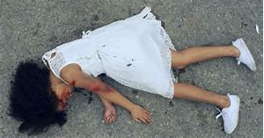
“... On the Other side of life…”
Lucas’ music video opens up to a little girl laying on the asphalt, bleeding from the head, all over her little white dress, motionless, unconscious, as she speaks from ‘The other side of life’. Though the direct lyrics say what is thought, about what one child could no longer do, such as dance, play with barbies and kiss her mamma one more time… “All because this stupid bitch wanted to text and drive”
Lucas was able to portray the loss of an innocent life in one picture to help emphasize the meaning of his lyrics

Slide 4
Texting and driving
Lucas tugs our heart strings by not only telling us the dangers of texting and driving, but by also portraying it in a visualization.
According to CBSNews distracted driving has killed over 6000 people in one year, and that was just in 2008, the numbers have dramatically been effected by the rise of cell phone use since that age
A separate report by Car and Driver magazine found that texting and driving is more dangerous than drunken driving.

Slide 5
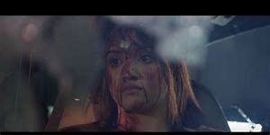
‘... auto peices, oil leakin…”
Lucas next focal point in the song would be to look at the life of a mother, who does homework with he daughter, cooks and cleans for her man, paryin and goin on instagram.
He list several different alternatives we can do to not risk our everyday lives… by drinking and driving; such as ubering, staying home, or even not goin to the store
In the music video we can tell that this can happen wo anyone wh omakes the decision, no matter what we can have our ‘bible open’ but that doesnt mean we also wont have a ‘bottle open,

Slide 6
Drinking and driving
The song points out one of, if not thee, most stupidest mistake any human being can do, which is drink and driving.
According to the NHTSA, almost 29 people die a day from alcohol impaired vehicle accidents, that's almost one every 50 minutes in the year 2016. Although the number has dropped over the past few decades, drunk driving claims the life of over 10,000 people a year, anywhere from educated people, to babies and infants, anyone can fall victim, due to someone's stupidity.
Drinking and driving can cost jail time, thousands to billions of dollars, and most importantly, lives.

Slide 7
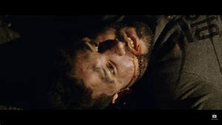
Reckless driving
“While im speeding, that shit gives me thrills…”
Lucas next point he brings up is reckless driving; whether its speeding, lane swerving, racing, or anything else, we all know that there are reckless drivers that are unavoidable, anywhere from the streets to freeways. The song even says “my mamma says if i dont chill, that shit goin get me killed”, which im sure we are all warned by our parents when we start to drive, but us young people seem to not care much about that, and i even admit at times i speed down the freeway, not giving a shit, just trying to get where im going.

Slide 8
Speeding and other reckless driving
According to after-car-accidents,com speeding is the 30% cause of an accident, with a number of over 10,000 speed related deaths occuring a year (as of 2015). And nearly half happened on roads where the speed limit was over 55 miles per hour, now that doesnt mean the the other 52% werent going over 55 miles an hour its just saying the speed limit in half those areas, were set at over 55, not the cars involved.

Slide 9
Overall 9/10
Lucas did a well job delivering his message with graphic images helping emphasize the importance of his points. I would say it is a real eye opener to people, such as i who have been guilt of any of these driving techniques. It is a reality check which guilts me into regretting my decisions made behind the wheel and will influence my driving skills.
It is the perfect day in age for this song to be heard because the dangers of driving is a very underrated topic which should be discussed more and more to everyone, especially, but not restricted to, young drivers

Slide 10
sources
1 https://www.after-car-accidents.com/car-accident-causes.html
2 https://www.nhtsa.gov/risky-driving/drunk-driving
3 https://www.cbsnews.com/news/distracted-drivers-kill-6000-last-year/
4 https://en.wikipedia.org/wiki/Joyner_Lucas

