Slide 1
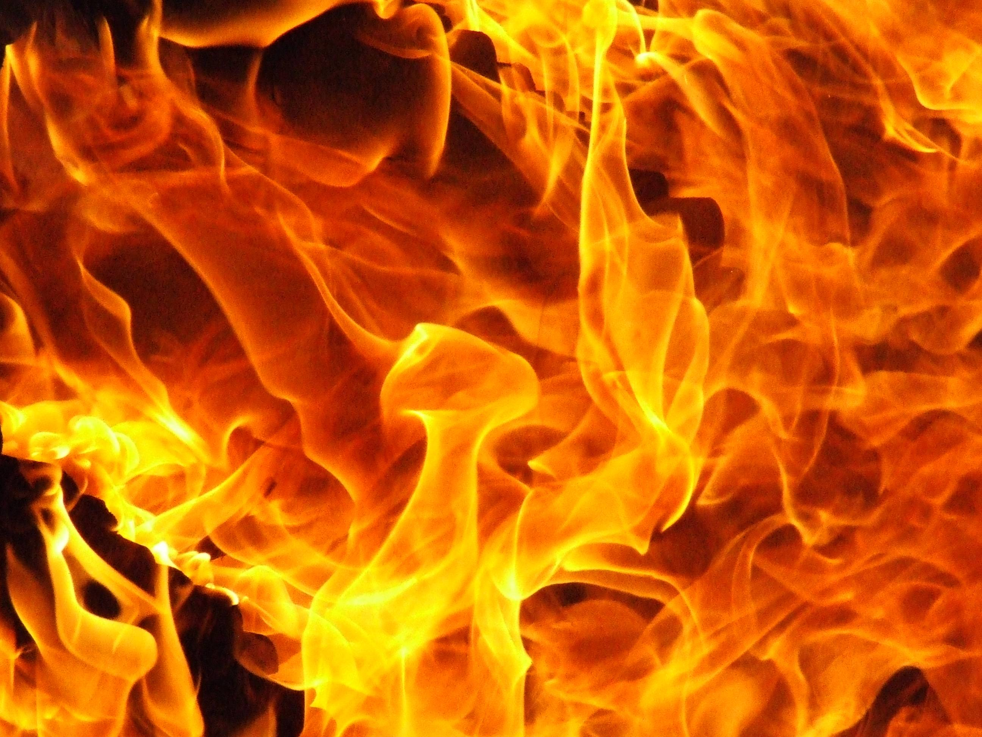
How to Become a Fire Fighter?
BY Kenneth McGray

Slide 2
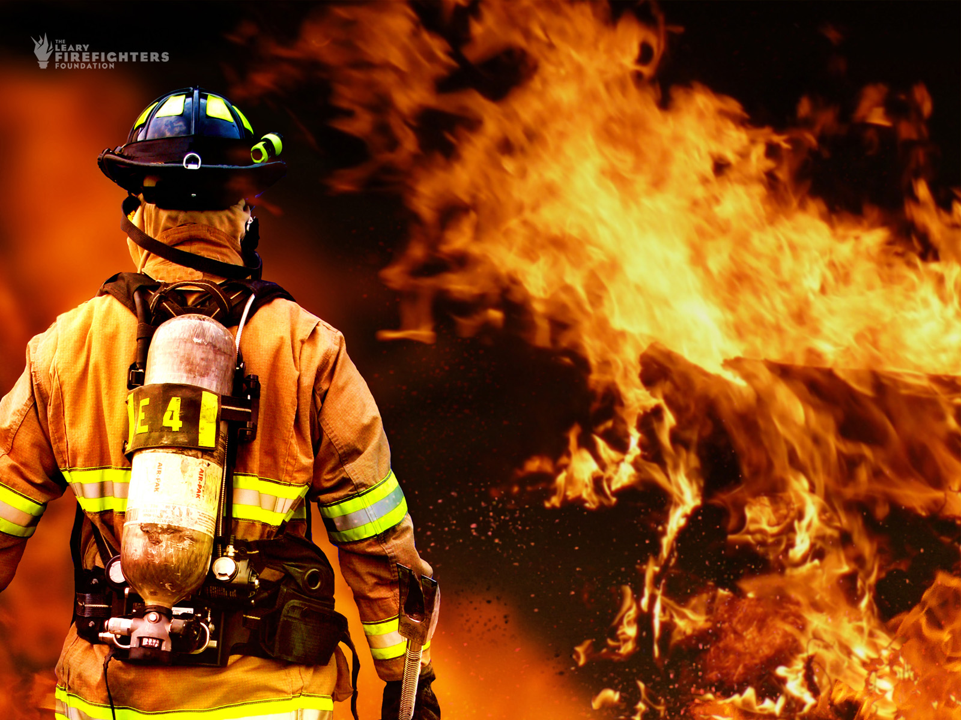
Intro
In this slide show I am going to talk about
The qualifications to become a Fire Fighter
The Salary
The PROs
The CONs
My interview

Slide 3
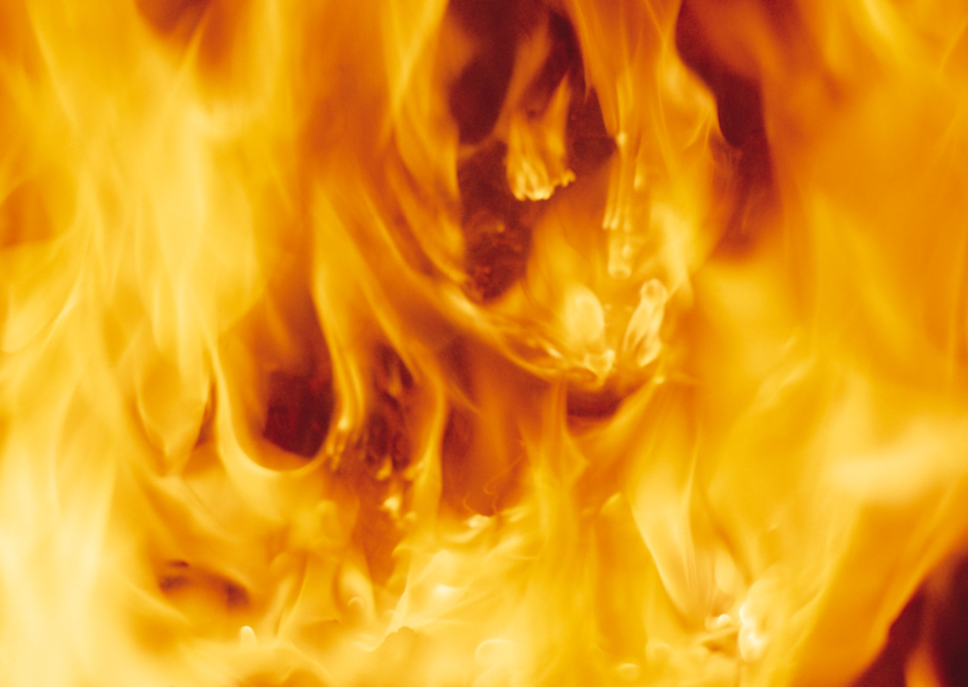
Requirements
Age
Education
Physically Fit
Clean Background
Pass the Written Exam + Pass the Psychological Evaluation
Graduate the Fire Academy
Ace the interview

Slide 4
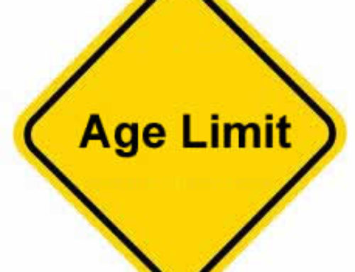
Age Requirement
Must be 18 years or older
In order to become a Fire Fighter to must be 18 or older and provide a valid drivers license. (Firerescue1.com)
But I’m not 18
IF you do not meet the age requirement then you can still get into JR Fire programs (Firerescue1.com)

Slide 5

Education
Must have a High School Diploma or equivalent to one
How do I get ahead in education?
  You can get a degree in Fire Science
Many Fire Fighter get there degree in Fire Science to advance there careers (Firerescue1.com)
  2. You can Become an EMT
Some Fire Departments might require you to be EMT ( Emergency Medical Technician) certification; larger departments may require a paramedic’s license. (klinoff)

Slide 6
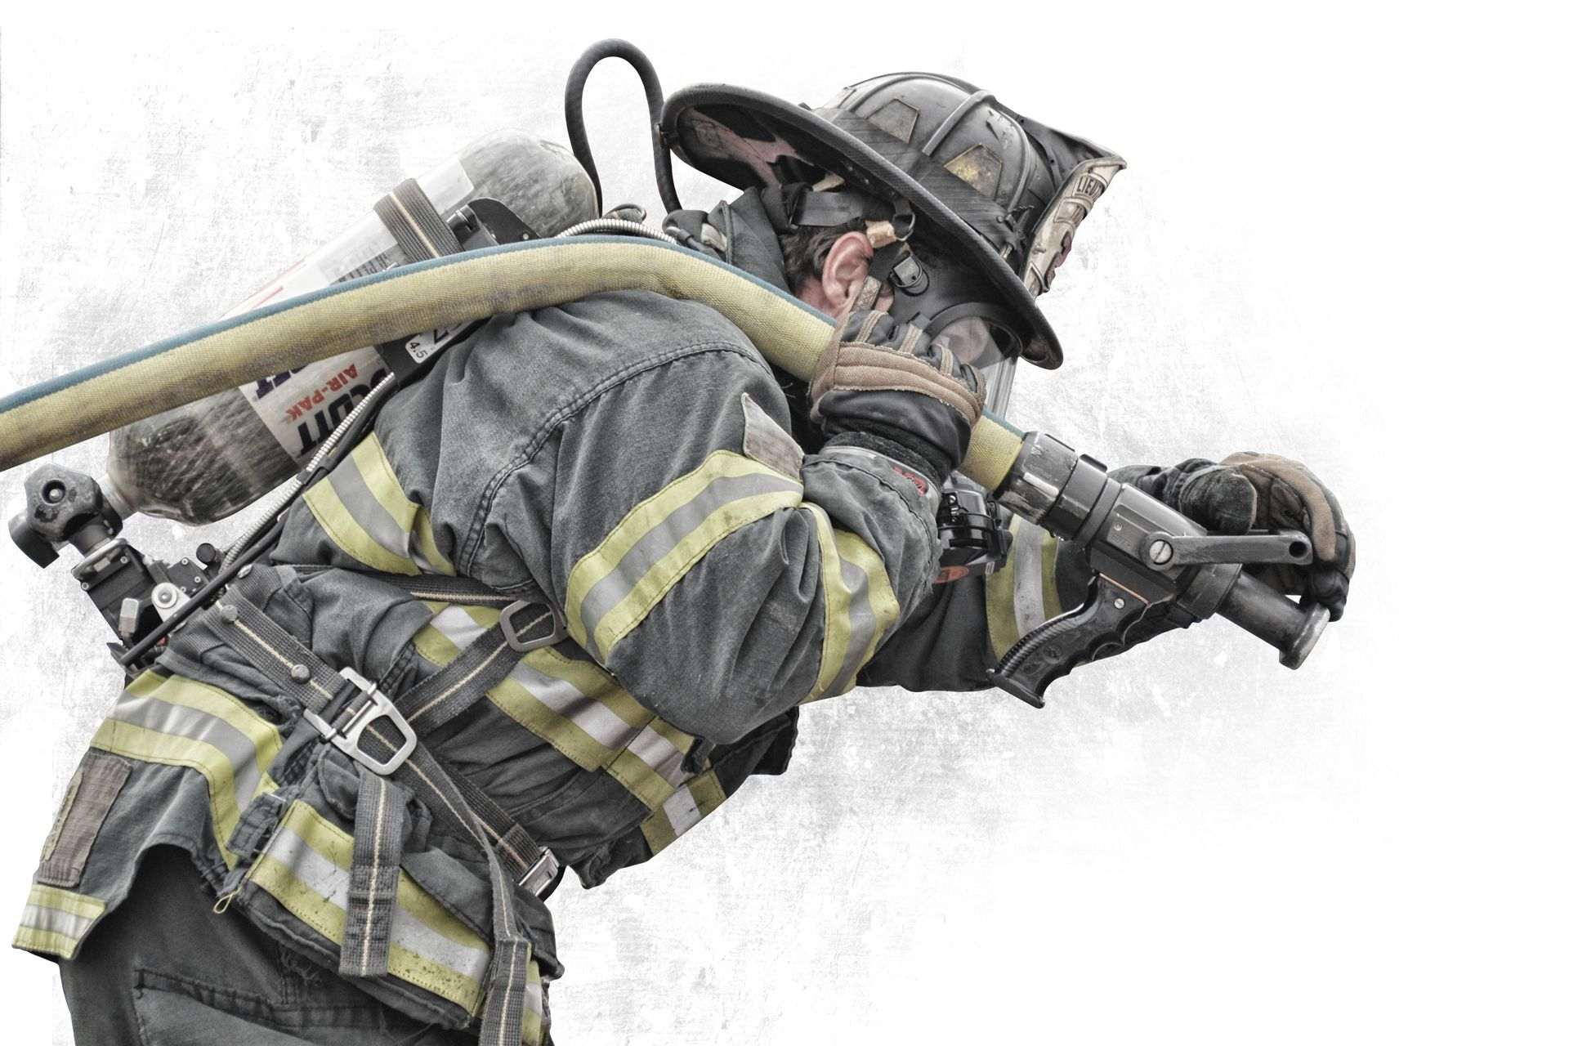
Physical Condition
Good Physical Condition
You will need to be in good physical shape for the reasons that you will possibly be saving life’s and the job is physically demanding and also you will need to pass the CPAT (Candidate Physical Ability Test). It is recommended from other fire fighters that you exercise consistently and do more job related exercises (klinoff).

Slide 7
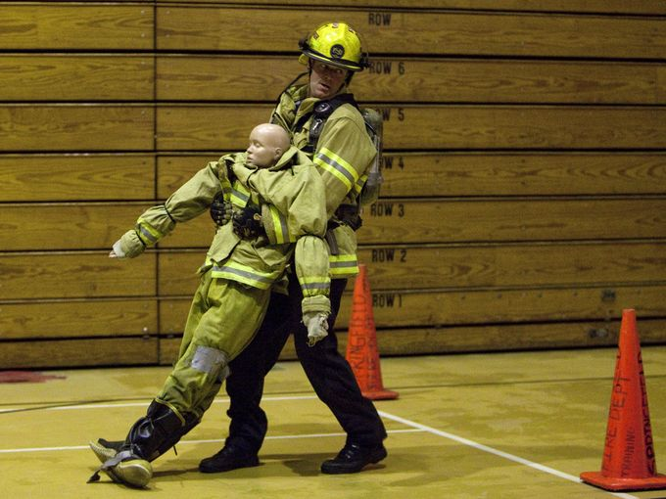
CPAT?
CPAT?
The CPAT is The CPAT events are
  Stair Climb
  Hose Drag
  Equipment Carry
  Ladder Raise and Extension
  Forcible Entry
  Search Rescue
  Ceiling Breach and Pull
  https://www.youtube.com/watch?v=f99Xh62jPC0
CPAT VIDEO

Slide 8
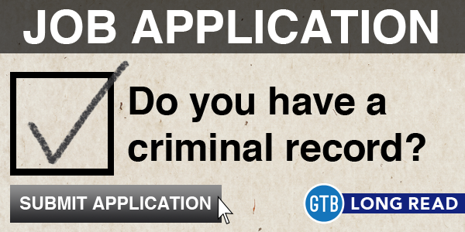
Your Record
You will need to pass a detailed background check
The Best way to get hired is to have and keep your nose clean
For Example
  NO DUI’s (Driving Under the Influence)
  No Criminal Record
  Zero Drug Use
It is recommended that you keep your social media clean also for the reason that a employer can view things that you post

Slide 9

Been in some trouble?
If you have been in some trouble don’t worry we all make mistakes . It is recommended that you do this.
  Be honest and own up to your mistakes
  Explain how You have fixed your mistakes since the incident and how you will avoid it in the future

Slide 10
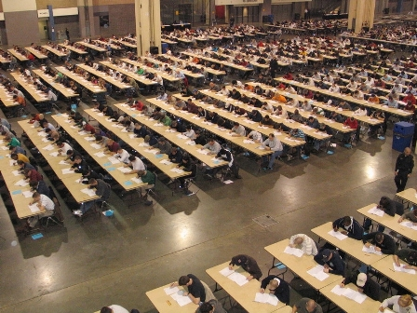
Written Exam+ Psychological Evaluation
You will need to pass the Written Exam. The Fire Fighter Written exam is a category up to 150 multiple choice test that measures your ability to be a successful fire fighter (Firerescue1.com)
  The categories are
  Mathematical reasoning
  Mechanical reasoning
  Reading comprehension
  Spatial orientation
  Situational judgement
  Observation and memory
Psychological Evaluation
This evaluation will test your mental and emotional stability to withstand the stresses associated with the everyday job as a firefighting.

Slide 11
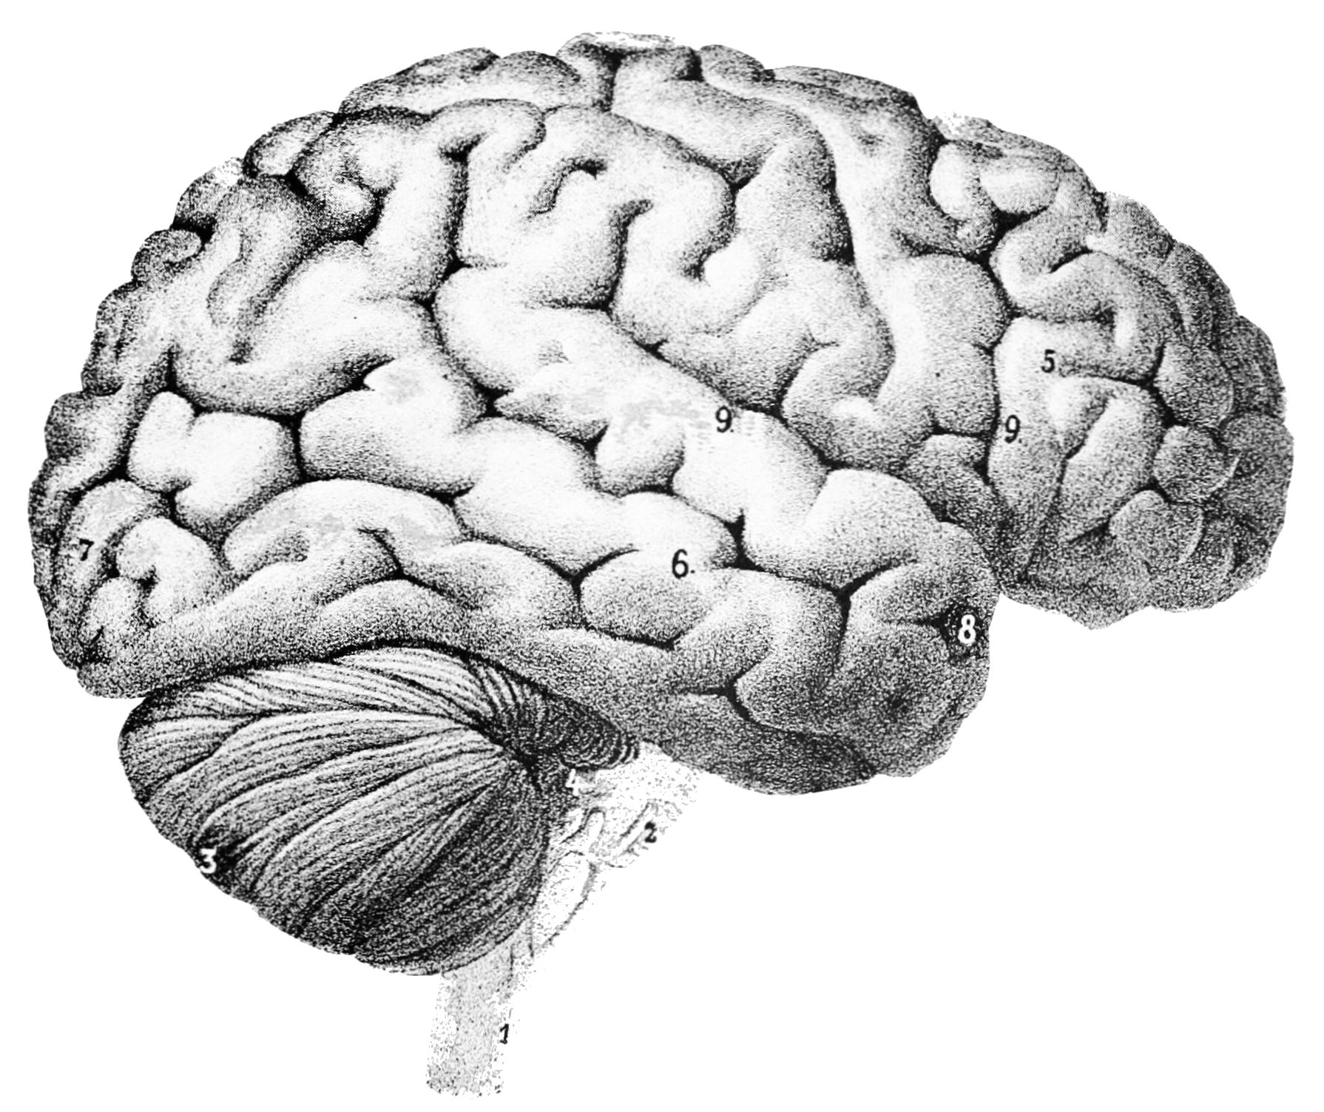
Psychological Evaluation
This evaluation will test your mental and emotional stability to withstand the stresses associated with the everyday job as a firefighting. (Firerescue1.com)

Slide 12
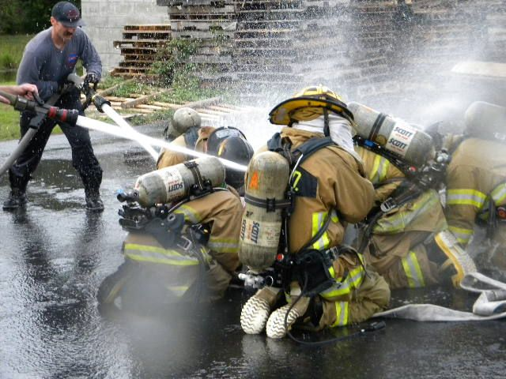
Fire Academy
You need to attend The Fire academy. At the Fire Academy you learn the book and practical skills of the job (klinoff).
How to get into the academy
  Get Hired as a Fire Fighter
  Become a volunteer Fire Fighter
  Sign up yourself for the academy

Slide 13

Ace the Interview
In order to get the job you will need to pass the interview. The interview can be a nervous situation. It is recommended to do some research on the fire department and study and practice the interview questions. The different type of questions that might be asked are. (Firerescue1.com)
  Who are you?
  What do you know?
  Why are you here?
  How would you react?

Slide 14

Salary + Growth
As of 2018
$49,620 per year
$23.85 per hour
As of 2016
Number of Jobs in 2016 - (327,300)
job out look is at 7%
Expected growth 2016-26 - (23,500)
(Occupational Outlook Handbook)

Slide 15
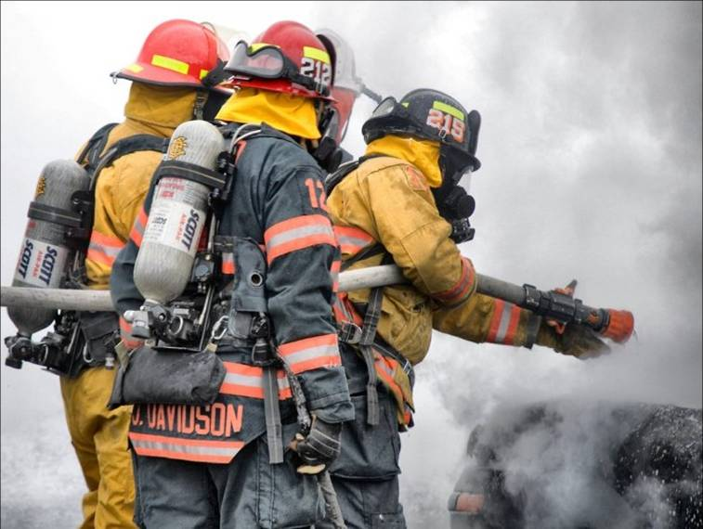
PRO’s
Enjoyable
Rewarding
Work with good people
Benefits
  Medical
  Dental

Slide 16
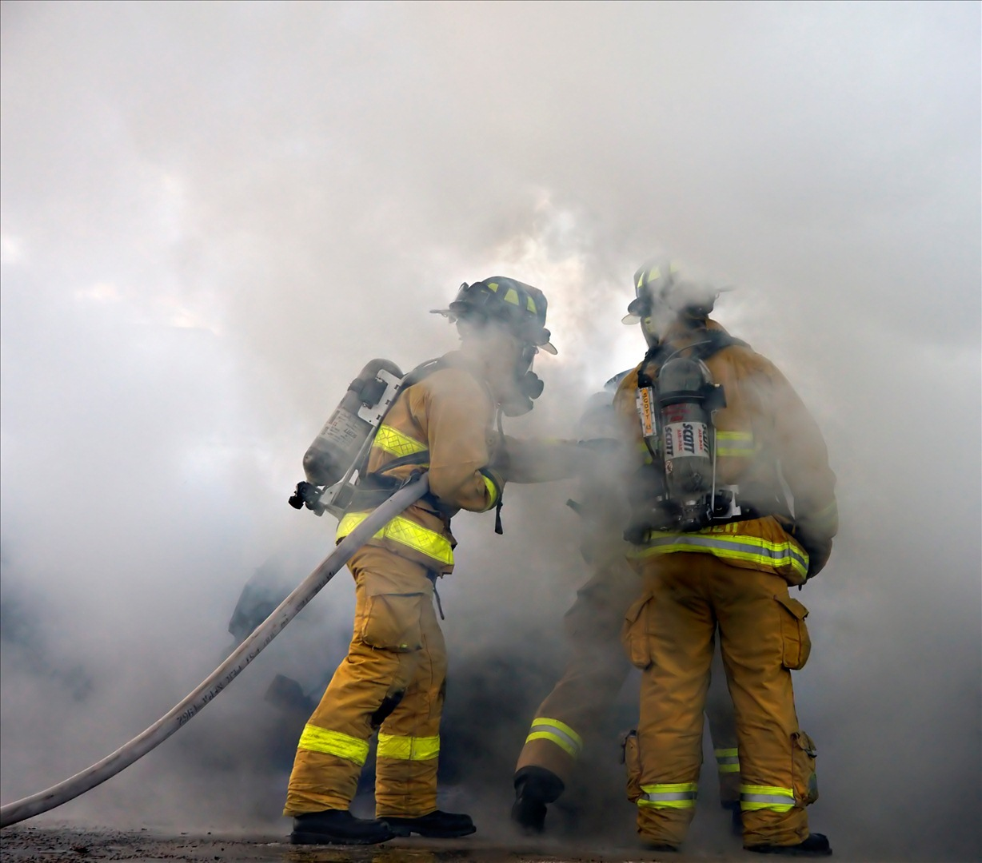
CON’s
Hard on the family
Mentally draining
Over time it takes a toll on the body
Dangerous

Slide 17
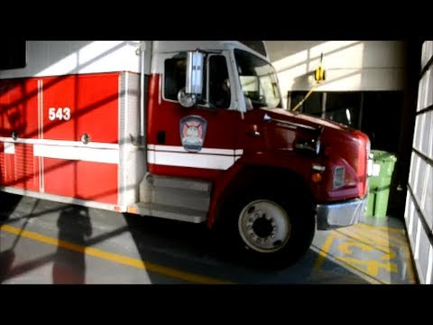
543 Interview

Slide 18
Question | Answer
When did you first start your career as a fire fighter? | I first started my career as a volunteer when I was 18 years old in 2008, and then in 2010 is when I started full time for Cal Fire in the city of highland
What does your family think about you being a fire fighter ? | At first my family was not supported because they wanted me to do something else to make more money. Also, they were worried about the risks, but in the end, they were proud
How long after the academy did it take to get your position as a fulltime fire fighter ? | Two and a half years
What type of shifts to expect ? | three or four 24 hour shift a week depending on what they have for personal
Dose having a college degree help ? | Dustin answered that he only did some general college classes, but he said that it Definity dose look good
what can I do to prepare for the academy | To exercise, eat right, and once I am there don’t give up
how can I prepare myself to be a fire fighter | He then added onto his last advice that when I work out I do more job-related workouts and to start to be a volunteer fire fighter
what steps can I take to become a fire fighter? | go to EMT school and other Pre-classes, and that it would also be good idea to volunteer as a fire fighter.

Slide 19
Annotated bibliography
“11 Requirements to Become a Firefighter.” FireRescue1, 24 Mar. 2017, www.firerescue1.com/Firefighter-Training/articles/224442018-11-requirements-to-become-a-firefighter/.
This paragraph is about the requirements it takes to become a fire fighter. I will use the information from this website to show what requirements it takes. I believe it is a reliability source because it is written by scholars and past fire fighters.

Slide 20
“4 Questions You'll Get in a Firefighter Job Interview.” FireRescue1, 29 Sept. 2016, www.firerescue1.com/fire-career/articles/130536018-4-questions-youll-get-in-a-firefighter-job-interview/.
This paragraph is about what some interview questions that you might be looking at. I will use
This website to show what might be some questions to look out for and practice for when you go for your interview. I believe it is a reliability source because it is written by scholars and past fire fighters.

Slide 21
“Firefighters: Occupational Outlook Handbook:” U.S. Bureau of Labor Statistics, U.S. Bureau of Labor Statistics, www.bls.gov/ooh/protective-service/firefighters.htm.
This webpage shows how much a fire fighter makes a year. I will use this website to show how
much possible that you could make. This is reliable because it is published by the Bureau of
labor.

Slide 22
Klinoff, Robert W. Introduction to Fire Protection and Emergency Services. Jones & Bartlett Learning, 2015.
This text book is a bunch of information on all aspects of being a fire fighter. I will use this text book because it has most of the information I need for my slideshow. This is a reliable source because it was used in my fire 100 class at Crafton and is published by scholar and recognized by other scalars and fire fighters.

Slide 23
McGray, Kenneth, and Dustin. “543 Interview.” pp. 1–4.
This is an interview I did on some firefighters at 543 in Highland. I want to use this info to show what a current fire fighter is saying about this job field. This is reliable because it is straight to the source and is coming from a current firefighter.

