Slide 1



WORKING SMARTER
Piloting Zero Net Energy to Guide Future College Growth
IN PARTNERSHIP WITH:
Notes:
Farrah

Slide 2



ZNE Pilot Program Highlights
Who is SBCCD
Meet our visionaries
SBCCD Sustainability Culture
Prop 39 ZNE Pilot Project
Meet Our Team
7 Stages of ZNE Journey
What’s next
Notes:
Farrah

Slide 3
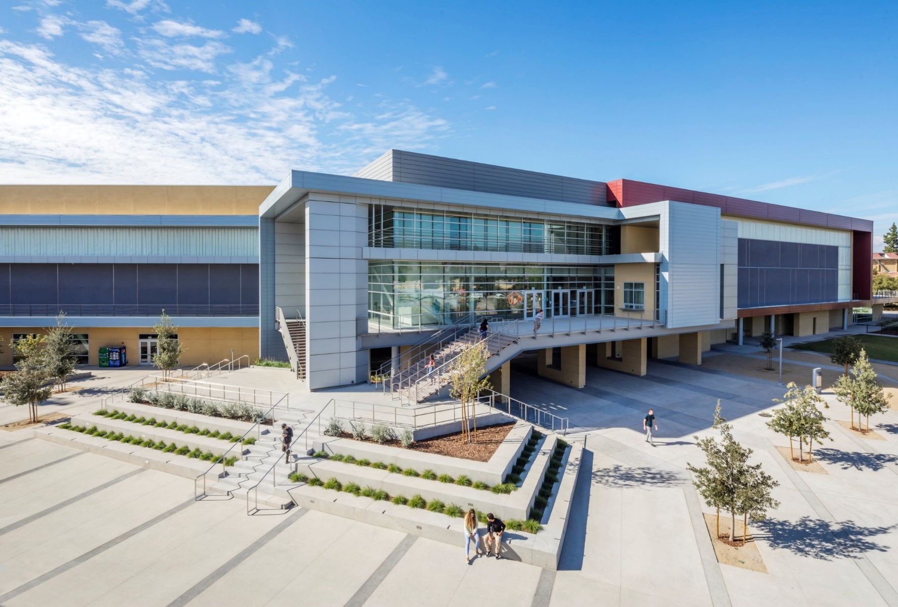



Who is SBCCD?
1 Out of 72 Community College
Districts in State of California
2 Out of 114 Campuses of
CCD system
4 Million people within its
geographical region
22 Cities and Communities within
its geographical region
25,000 students served annually
1 Million square-feet and 57
facilities district-wide
$621,800,000 Dollar contribution annually for regional economic impact
Notes:
Farrah

Slide 4
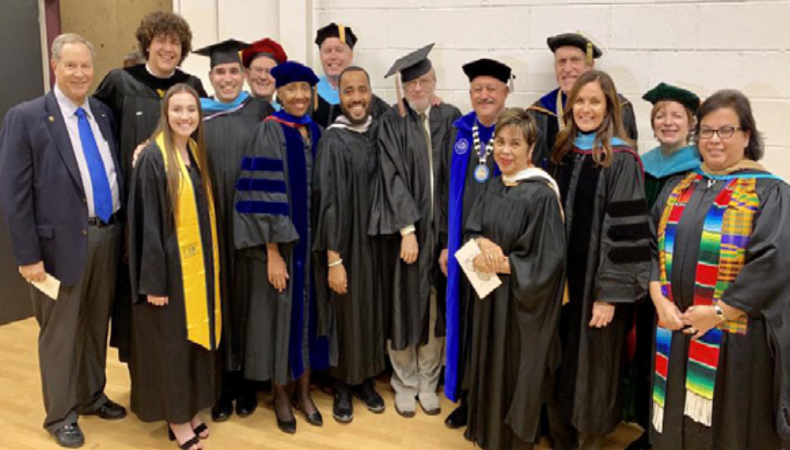
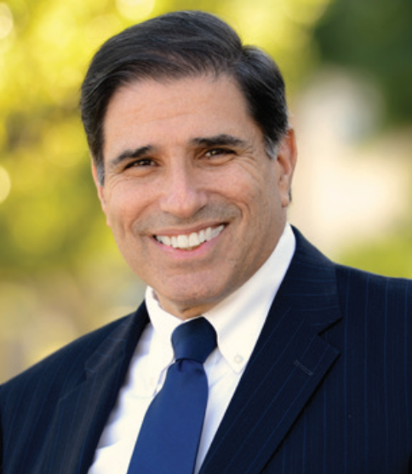
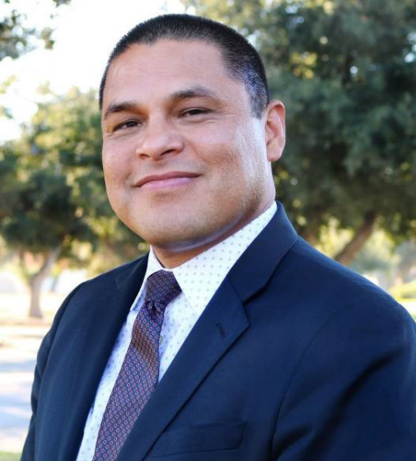
SBCCD Visionaries
Board of Trustees:
  John Longville, President
  Dr. Anne L. Viricel, Vice President
  Joseph Williams, Clerk
  Gloria Macias Harrison, Member
  Dr. Stephanie Houston, Member
  Frank Reyes, Member
  Dr. Donald L. Singer, Member
  Autumn Blackburn, Student Trustee
  Elijah Gerard, Student Trustee
SBCCD Leadership:
  Bruce Barron, Chancellor
  Jose Torres, Executive Vice Chancellor
  Diana Rodriguez, President, SBVC
  Dr. Kevin Horan, President, CHC
Notes:
Farrah

Slide 5
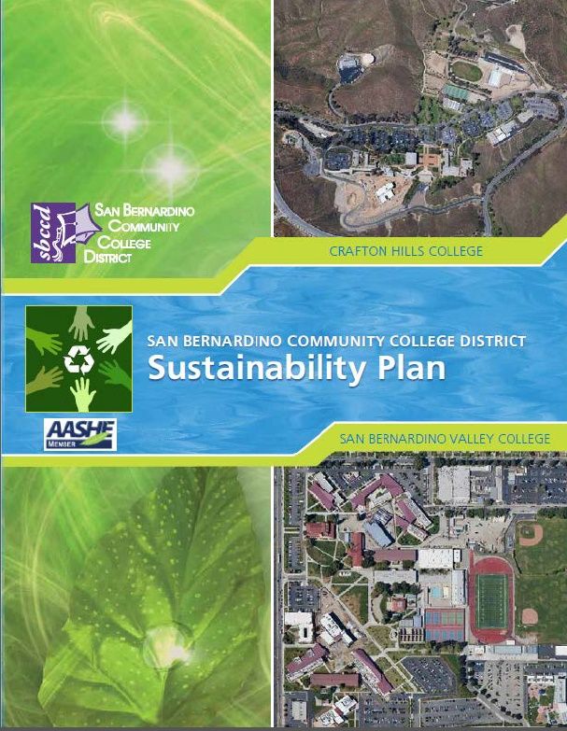
7 Goals of Sustainability Plan
Create a campus-wide culture of sustainability
Incorporate sustainability into the development of new and renovated facilities
Invest in renewable energy and energy efficiency programs
Develop a more sustainable transportation system
Develop a more sustainable system for the purchase of supplies and materials
Enhance curricular educational opportunities for sustainability
Establish a commitment to climate action
Notes:
Farrah will introduce Efren
Sustainability is a culture
2010 Participation @ American college and university presidents’ climate commitment
2010 Board policy (3580)
2011 Committee membership
2012 Sustainability plan adopted. Long term dedication & commitment by BOT, chancellor, colleges presidents, community stakeholders
2012 Alternate energy conception plan
2012 Energy conservation plan
2012 Behavioral changes – educational component
2010 - 2017 (10) LEED Certified projects districtwide
2013 SBVC central plant + CHC solar farm
2016 CHC recyclable water for campus irrigation
2017 - 2022 Facilities master plan
2018 Sustainability & Energy Manager
2018 - 2019 Integrated energy & sustainability master plan

Slide 6
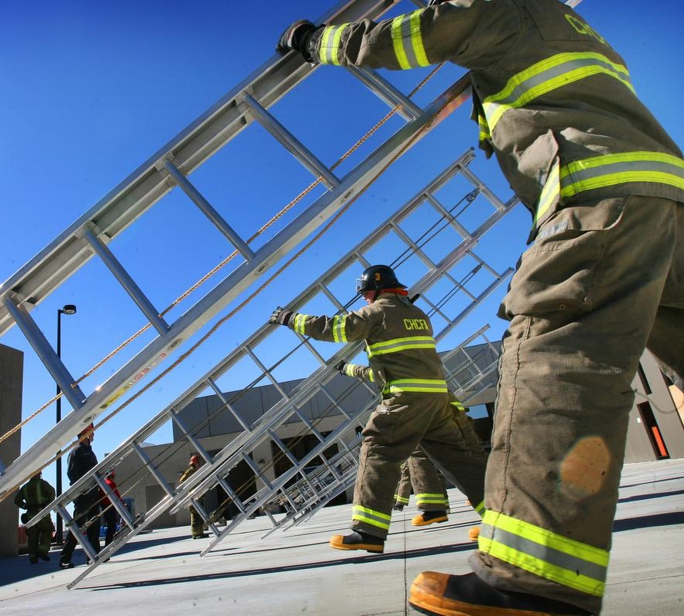
SBCCD Prop 39 ZNE SCE Pilot Project
Program Goals
ZNE projects: California Public Utilities Company’s (CPUC) Proposition 39 ZNE for Schools Pilot Program. Funds for Prop 39, The California Clean Energy Jobs Act, are helping schools across California with the state’s goals to reduce energy use and greenhouse emissions. ​
Leverage Prop 39 funds​
Retrofitting “existing” buildings
Establish “Proof of Concept” of feasibility
Document findings & Best Practices​
Future Program Development
Prop 39 ZNE Value to Schools
Socialize awareness to stakeholders
District staff members, teachers, students, parents, & community
Design Assistance
Training
Implementation & on-going maintenance of these retrofits
After an extensive screening process by SCE, SBCCD is the only CCD in Southern California selected to participate in this innovative program
Notes:
Efren

Slide 7
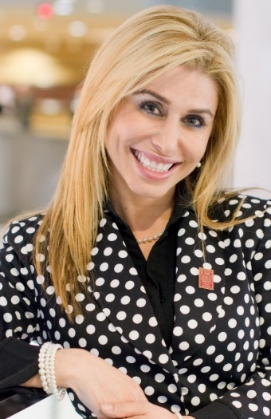
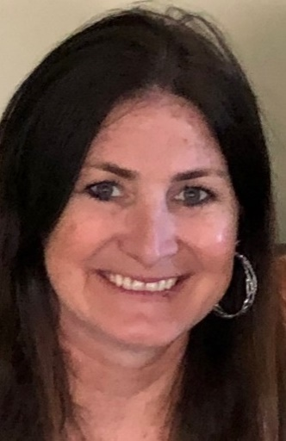
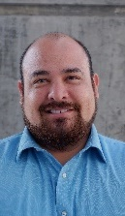
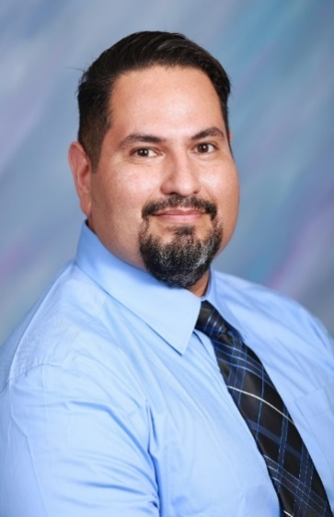
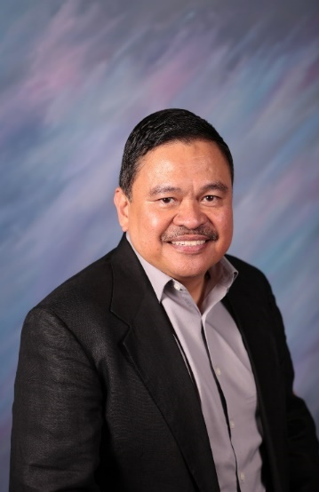
Meet Our Team –
SBCCD and Utility Partners
San Bernardino Community College District – District Support Services
Southern California Gas Company – Business Customer Division
Southern California Edison – Engineering Project Management – Emerging Technologies and Business Customer Division
Farrah (SBCCD)
Lisa (SCE)
Gustavo (SCG)
Robert (SCE)
Efren (SCE)
Notes:
Efren

Slide 8
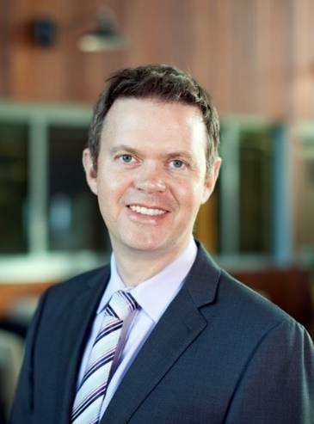
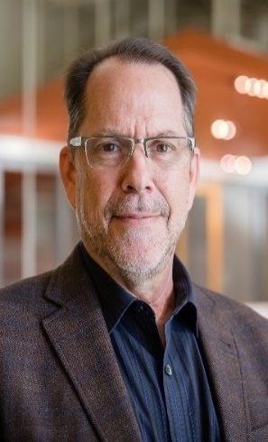
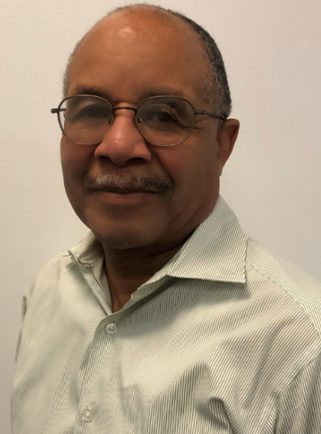

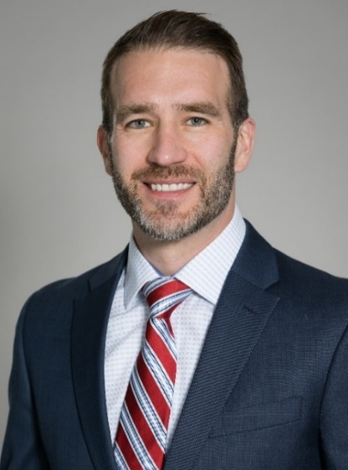
Meet Our Team –
Technical Advisors
SBCCD’s Technical Consultants:
ARUP – Sustainability and Energy consultants
HMC Architects
ENGIE (Mechanical Consultant)
SCE’s Technical Consultants:
Cadmus – project design report consultant
Agile environments (Cadmus lighting specialist sub-consultant)
Noresco – M&V and final report consultant
Martin (ARUP)
Ken (HMC)
Gregory (Engie)
Sahar(Cadmus)
Rick (Noresco)
Notes:
Farrah and Efren

Slide 9
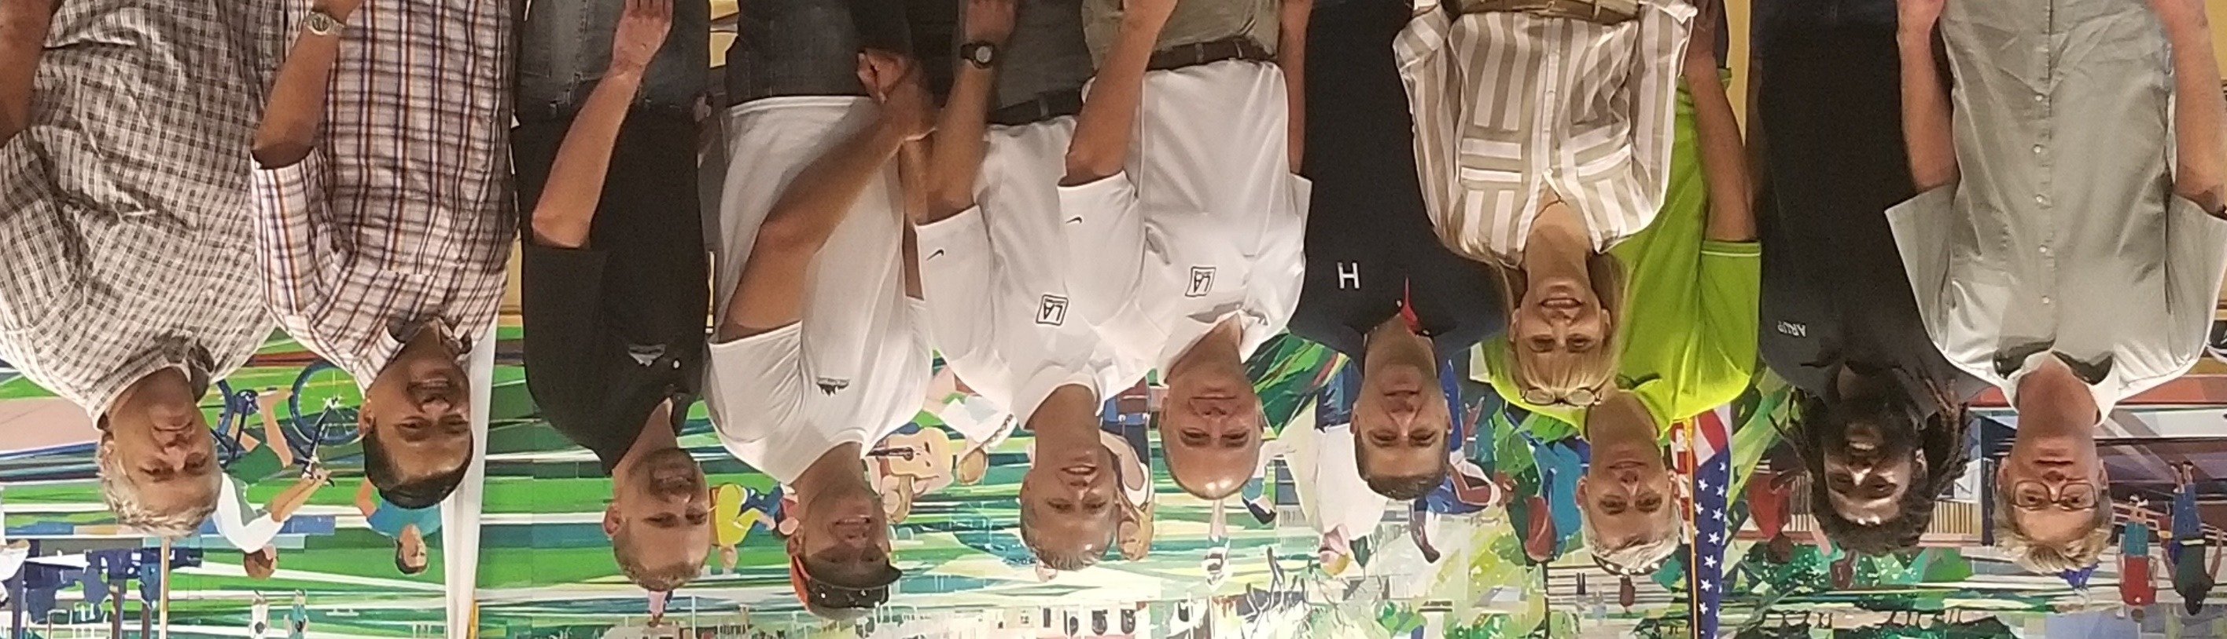
Meet Our Team – SBCCD Implementation Contractors
Three peaks corporation/Titan Electric (electrical/lighting contractors)
SDSTATURE (Tubular Daylighting Device Contractor)
LA Air-conditioning (Mechanical Contractor)
Sunbelt Controls (HVAC Direct Digital Controls Contractor)
Lemay Construction (Plumbing Contractor)
Awesome Blinds (Automatic Shading Contractor)
Integrated Comfort Inc. (Pre-coolers installation)
Knowland Inspection (project inspectors)
Notes:
Farrah and Efren

Slide 10






Meet Our Team – Manufacturing Partners
SunPower
  Solar PV system
EnOcean
  Wireless Controls
L.A. Lighting Manufacturing Co., Inc.
  LED Retrofit Kits & new LED Luminaires
Solatube
  Tubular Daylighting Devices
Integrated Comfort Inc.
  A/C Unit Pre-coolers
Automated Logic Co.
  Direct Digital Controls
Notes:
Farrah and Efren

Slide 11




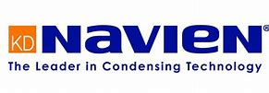
Meet Our Team – Manufacturing Partners
Trane Air-Conditioning Co.
  Ultra high efficiency A/C units
Onset
  HOBO Data Loggers
Sigler
  Carrier ATTC high efficiency A/C units
Mechoshade and Thermeshade
  Automatic Shading
Navien
  Tankless Instantaneous Gas Water Heater
Notes:
Farrah and Efren

Slide 12
Prop 39 ZNE Pilot Program Process
SCE
Cadmus
SBCCD and Consultants
NORESCO
Kick-off
Audit & Modeling
Design & Construction
ZNE Verification
This is where we are today
Recommend measures to:
Achieve source ZNE
Reduce site EUI from 41 to 23 kBtu/sq.ft.-yr
Notes:
Sahar

Slide 13
1
DESIGN PROCESS
Notes:
Sahar

Slide 14
Installed Energy Conservation Measures
Additional Measures: Shut-off controls on HVAC, Boardroom LED retrofit, HVAC VVT to VAV in District Office.
ECMs Proposed | ECMs Installed
New HVAC controls | Customized Algorithm
New RTUs – District Office | Ultra-efficiency
Evaporative condenser add-on | Unique application for SBCCD
New RTUs – Training Center | Three new AC units with VAV
Convert units to VAV - District Office | Added VAV and converted from VVT
New gas water heater | High-efficiency condensing tankless
Plug load management | Controllers on vending machines
LED lighting conversion | Retrofit kits (custom) with wireless controls
Automated shading | With additional thermal shading and controls
Light pipes | 17 Solatubes with motorized dampers and controls
Notes:
Sahar
ECMs are grouped by HVAC - DHW - Plug - Lighting. the HVAC measures are in descending order of savings, ECM_1 is the highest savings.

Slide 15
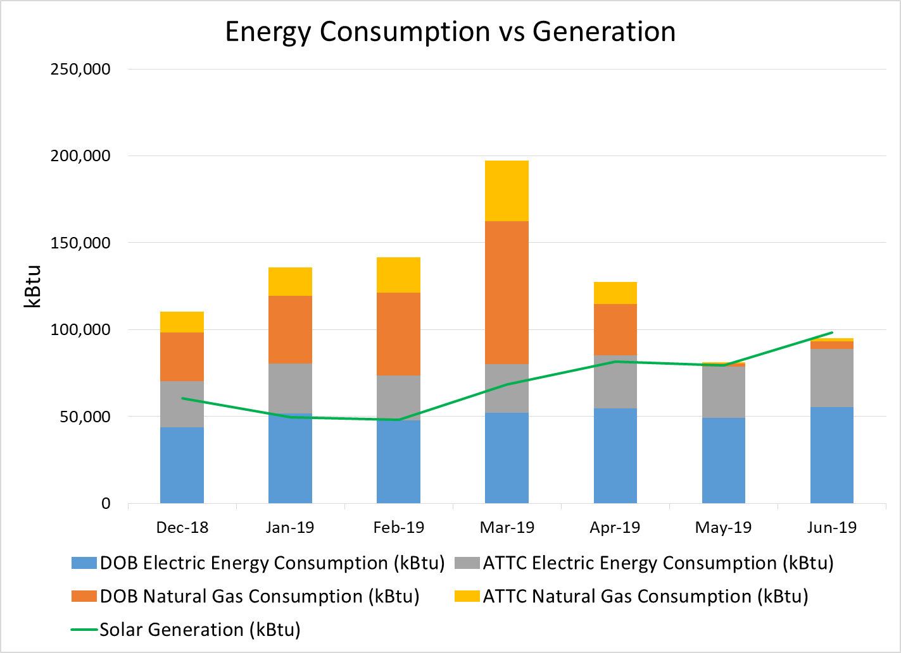
Site ZNE Projections
The M&V effort identified a scheduling issue as the cause of excess natural gas consumption. This was corrected in May 2019.
Notes:
Sahar

Slide 16
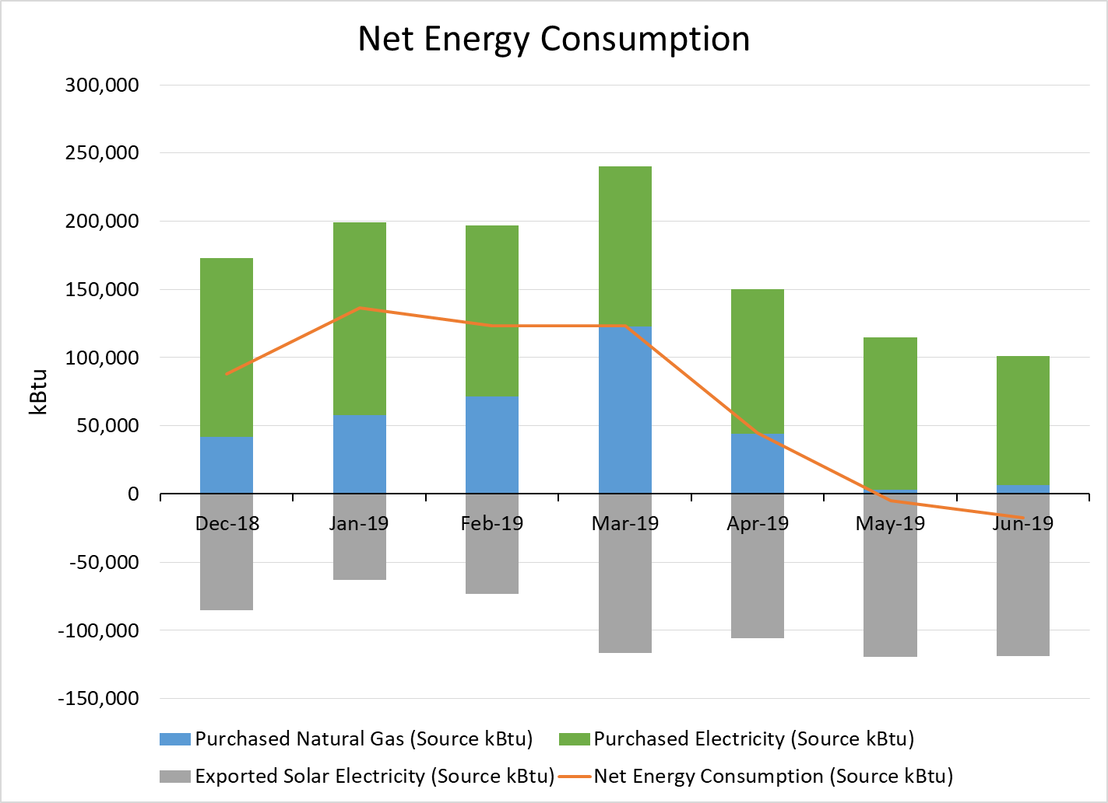
Source ZNE Projections
Notes:
Sahar and she will introduce LA Lighting – Mark Jarel

Slide 17
2
MANUFACTURING SOLUTIONS

Slide 18
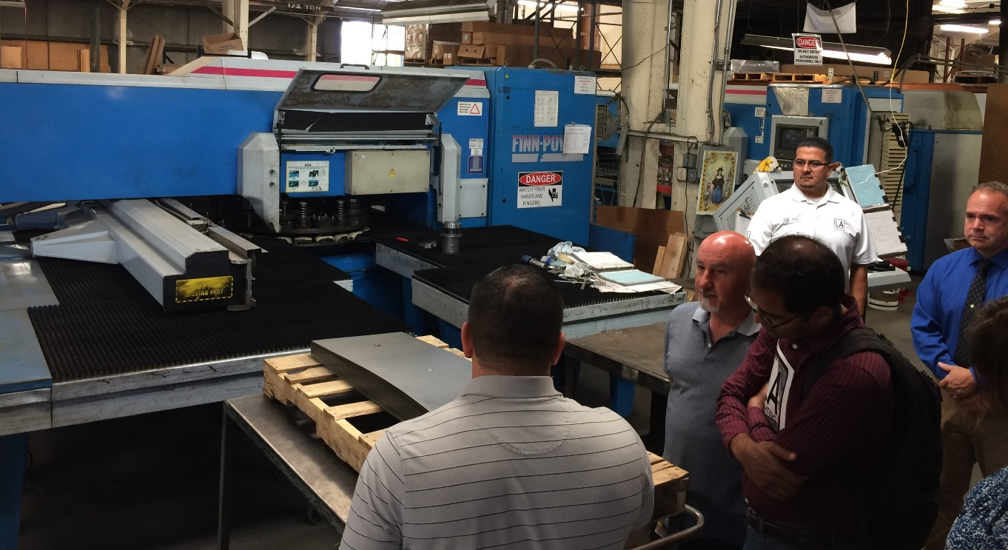
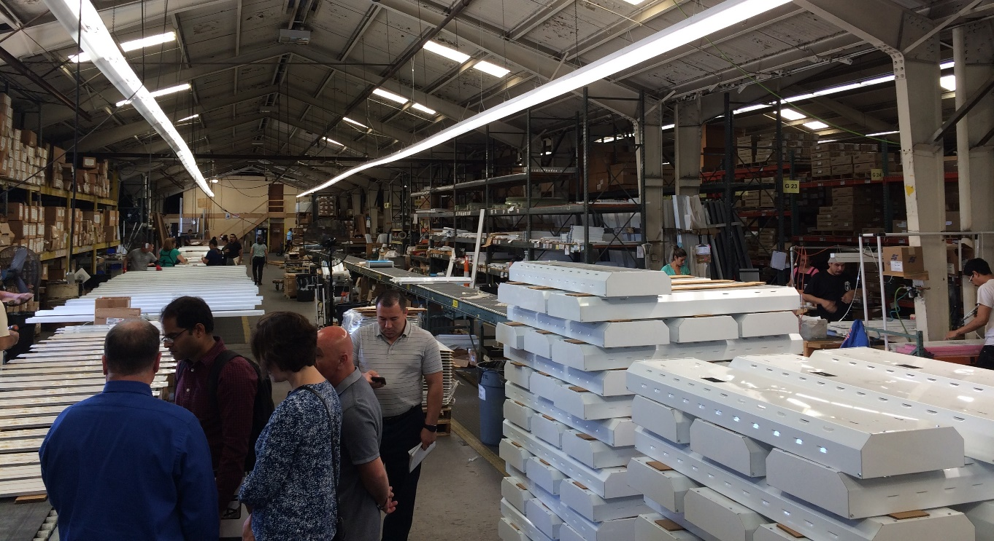
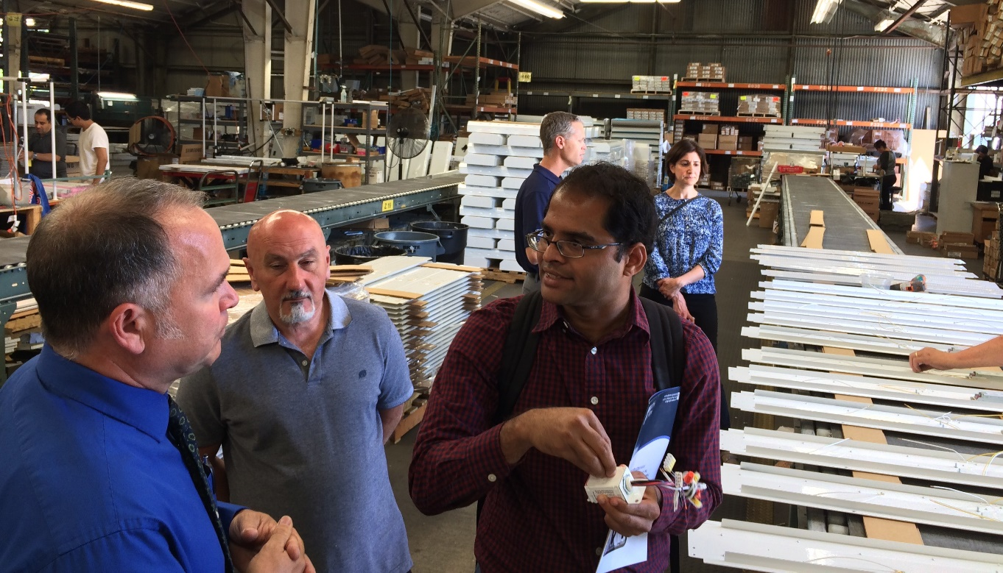
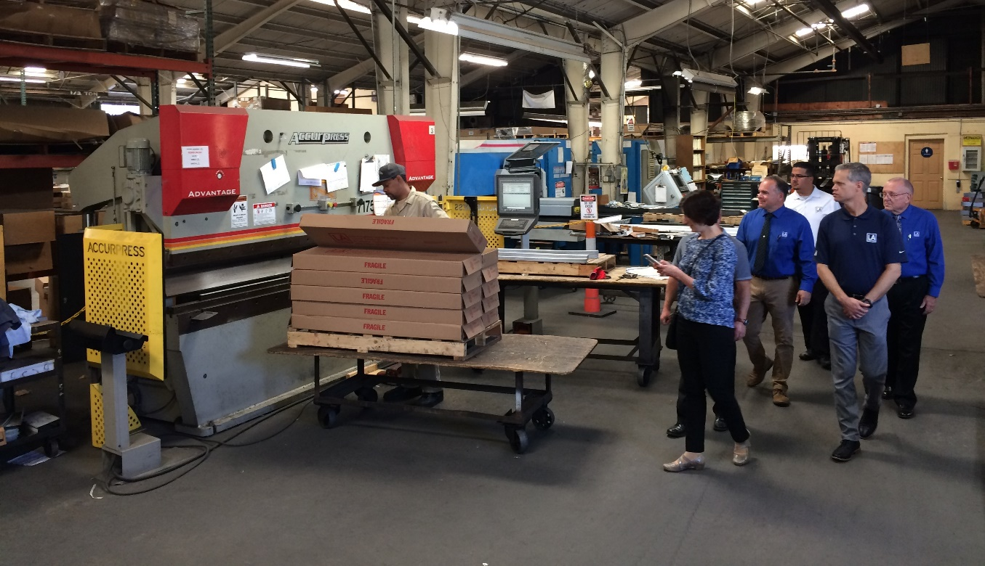
LA Lighting Factory Tour and SCE Lighting Lab Tour
Notes:
Mark will begin with LA Lighting tour

Slide 19
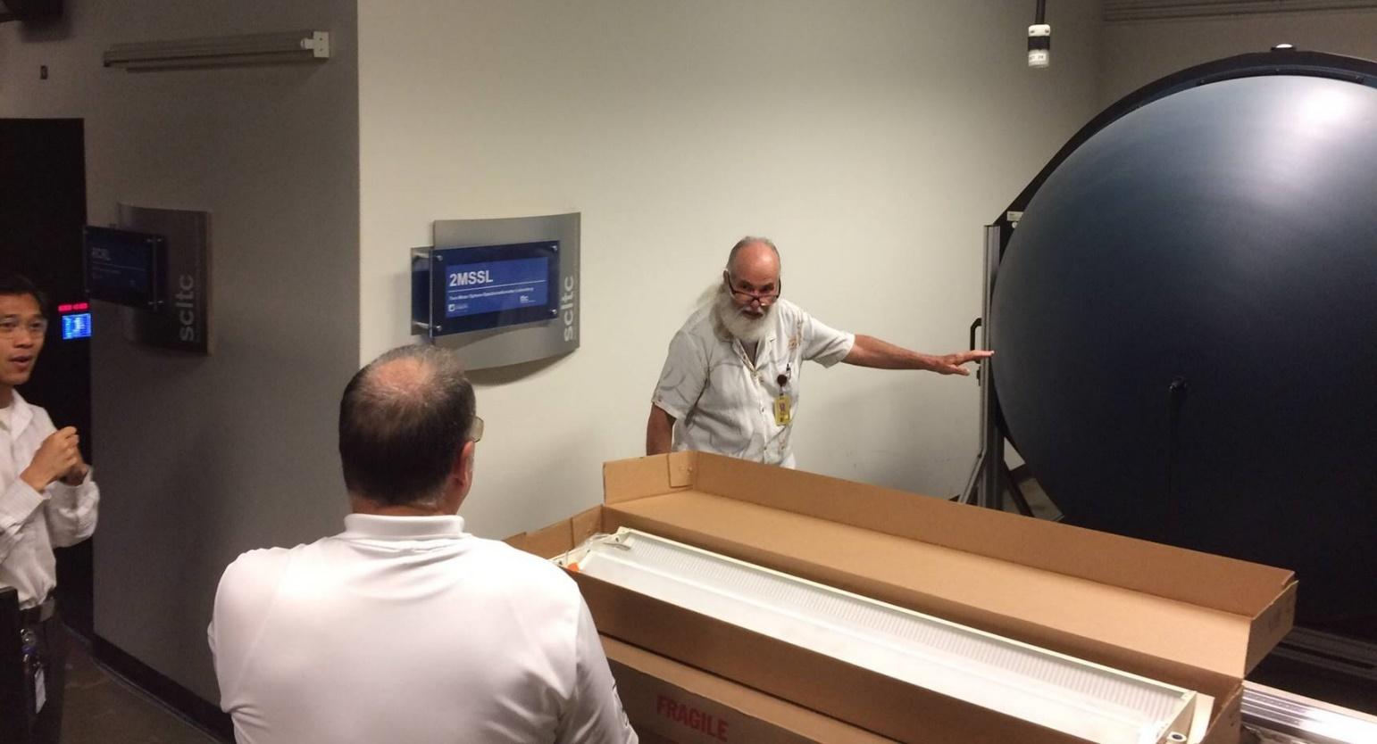
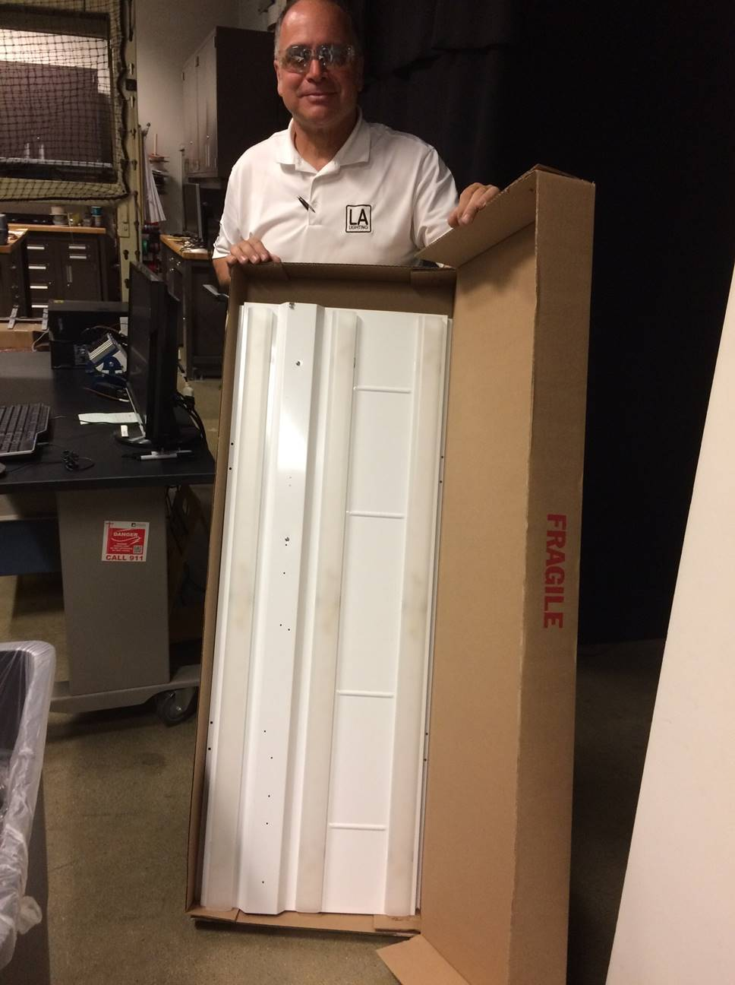
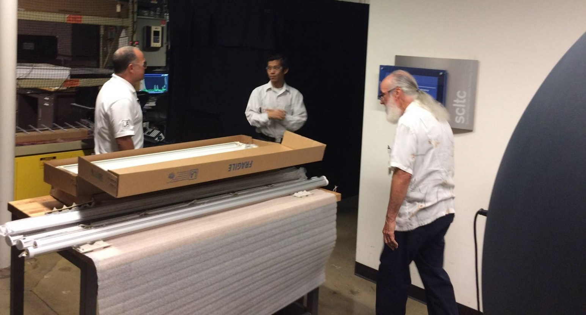
LA Lighting Factory Tour and SCE Lighting Lab Tour

Slide 20
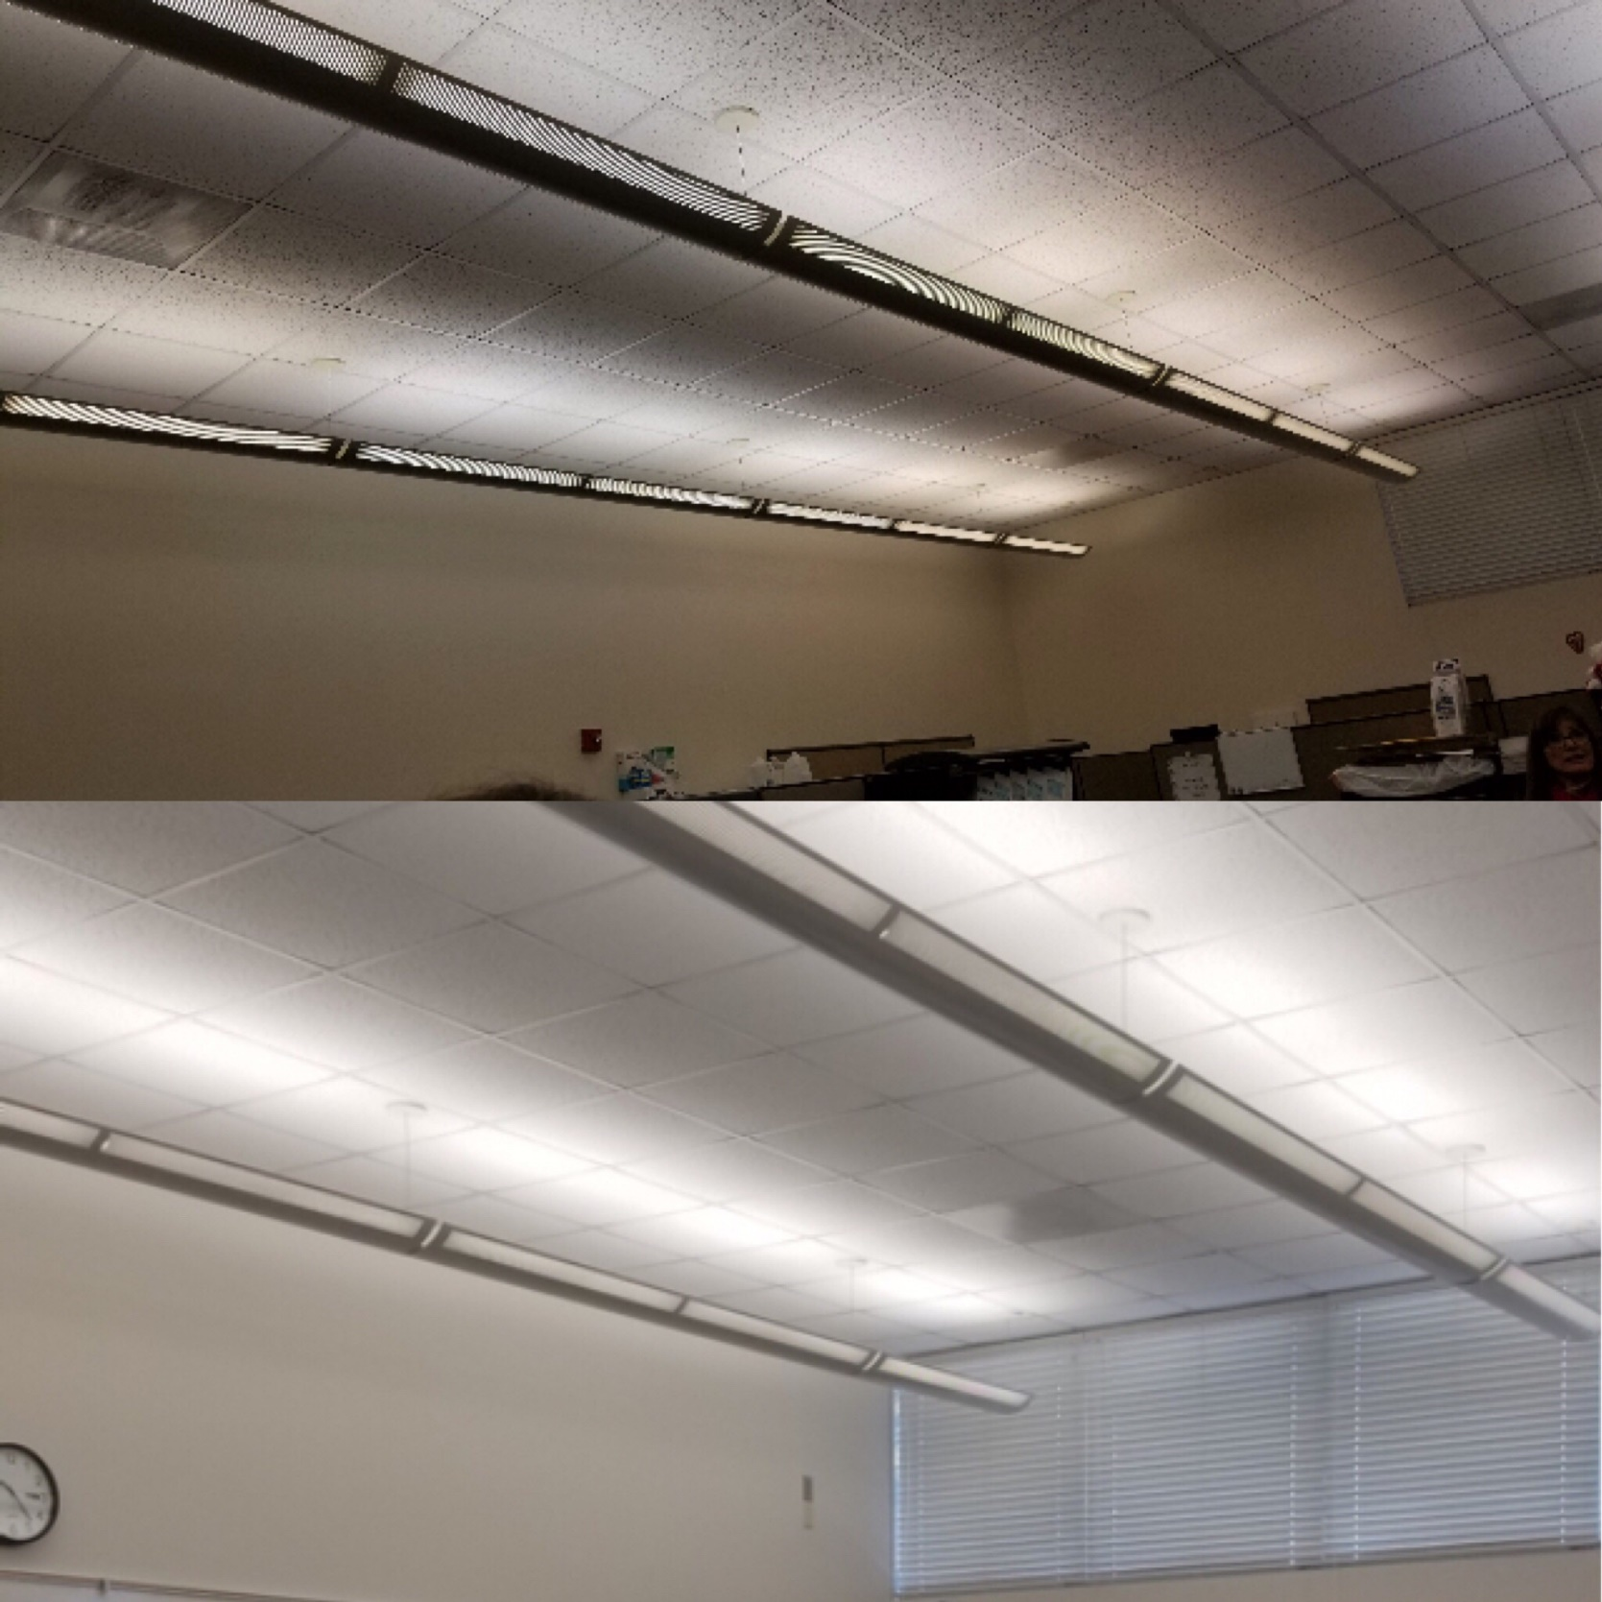
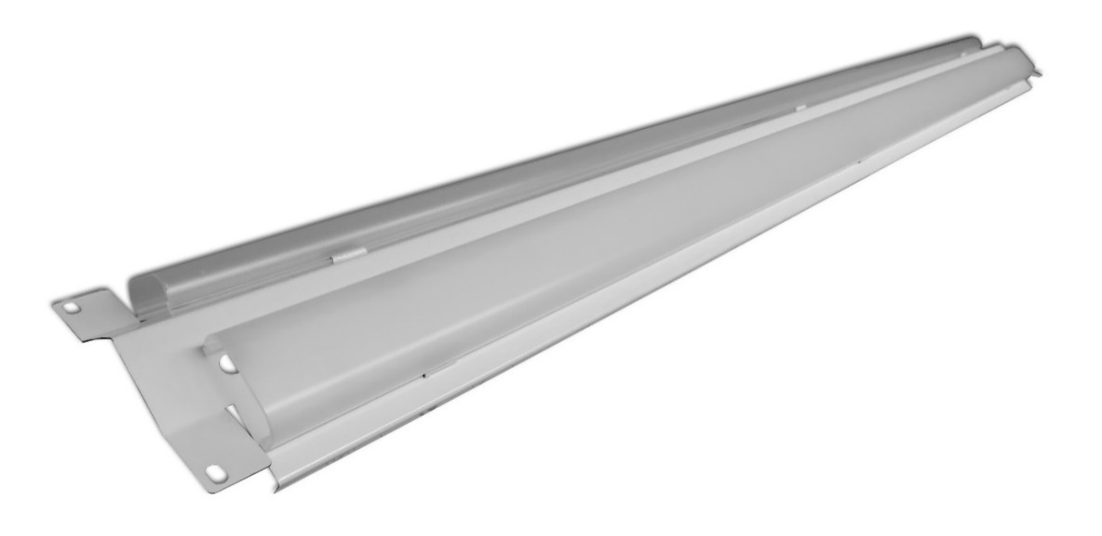
LED Lighting Retrofit
Custom Design Retrofit
14-day Lead Time
Improved Lighting Levels with Existing Fixture
Reduce Energy Consumption by 60% +
Notes:
Mark

Slide 21
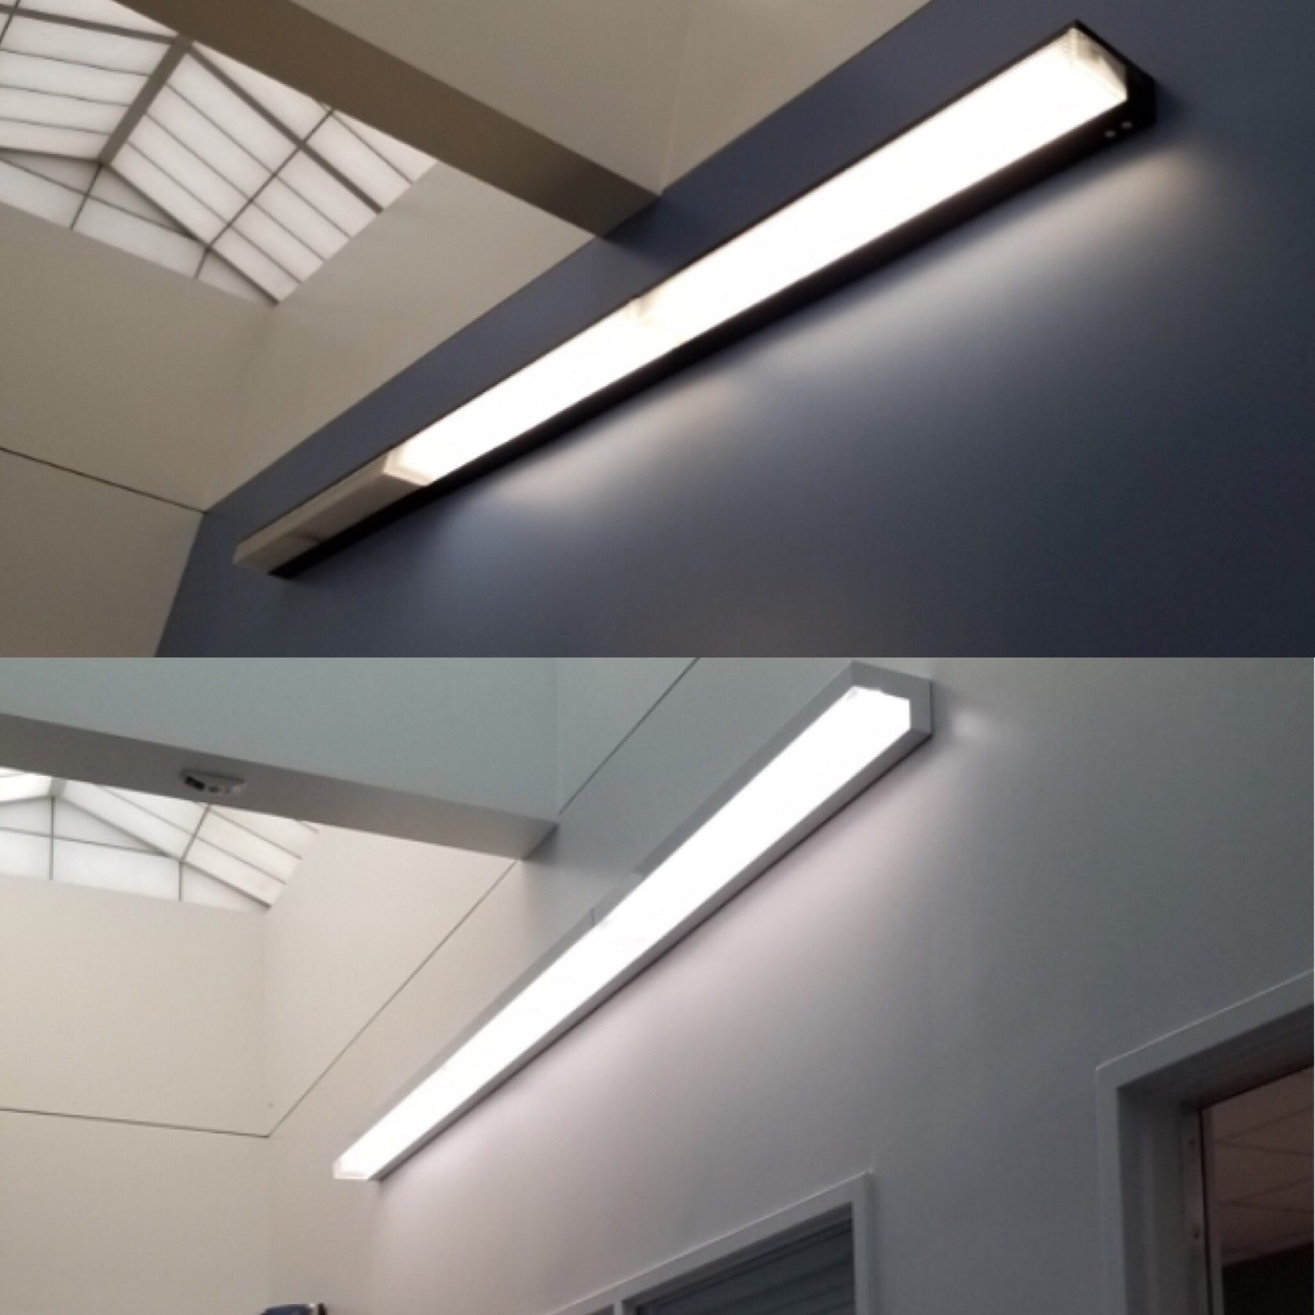
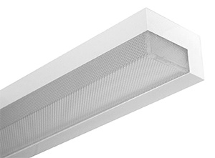
LED Lighting Fixtures
Remove & Replace Wall Mounted Fixtures with LED
Similar Design, Improved Performance
Reducing Energy Consumption 60% +
Notes:
Mark

Slide 22
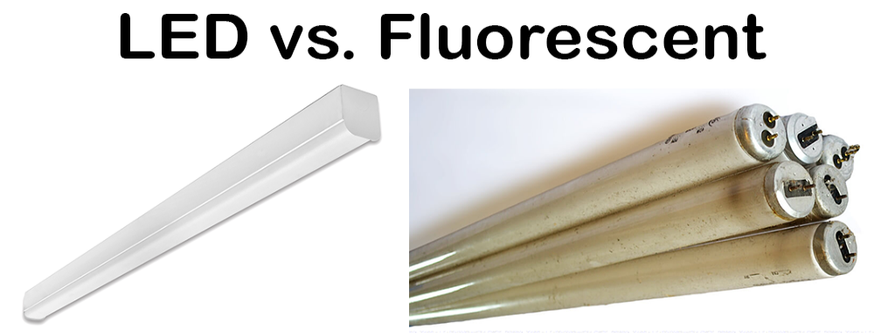
LED vs. Fluorescent
LED
  16-Watt Consumption
  1976 Directional Lumens
  60,000 hrs.
  No Hazardous Materials
  100% Recyclable
Fluorescent
  32-Watt Consumption
  2200 Omnidirectional Lumens
  10,000 – 15,000 hrs.
  Contains Mercury
  Hazardous Disposable

Slide 23
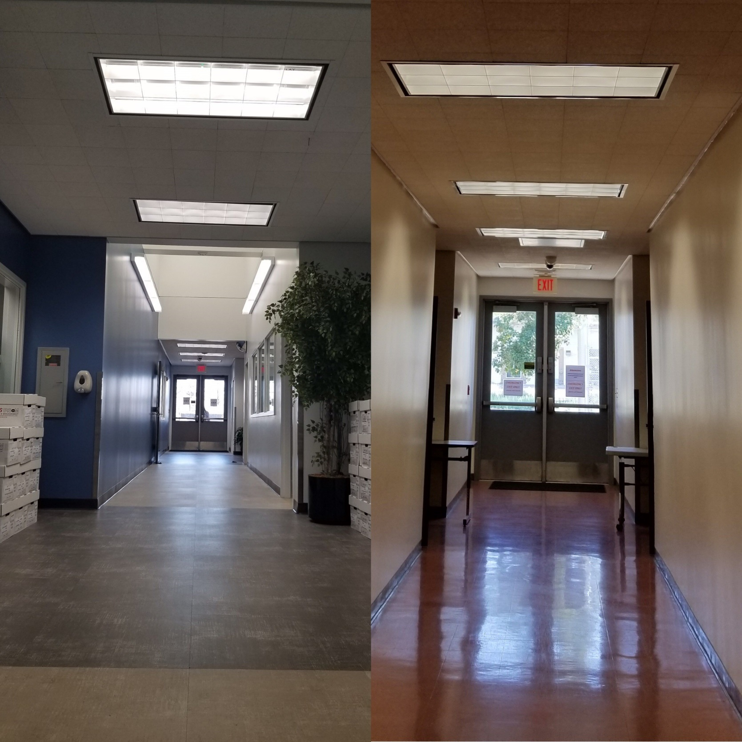
LED Retrofit Solution
Retrofitted Existing Fluorescent Housing
  5-minute Install
  Reducing Overall Labor Cost
Reducing Consumption 60% +
Notes:
Mark

Slide 24
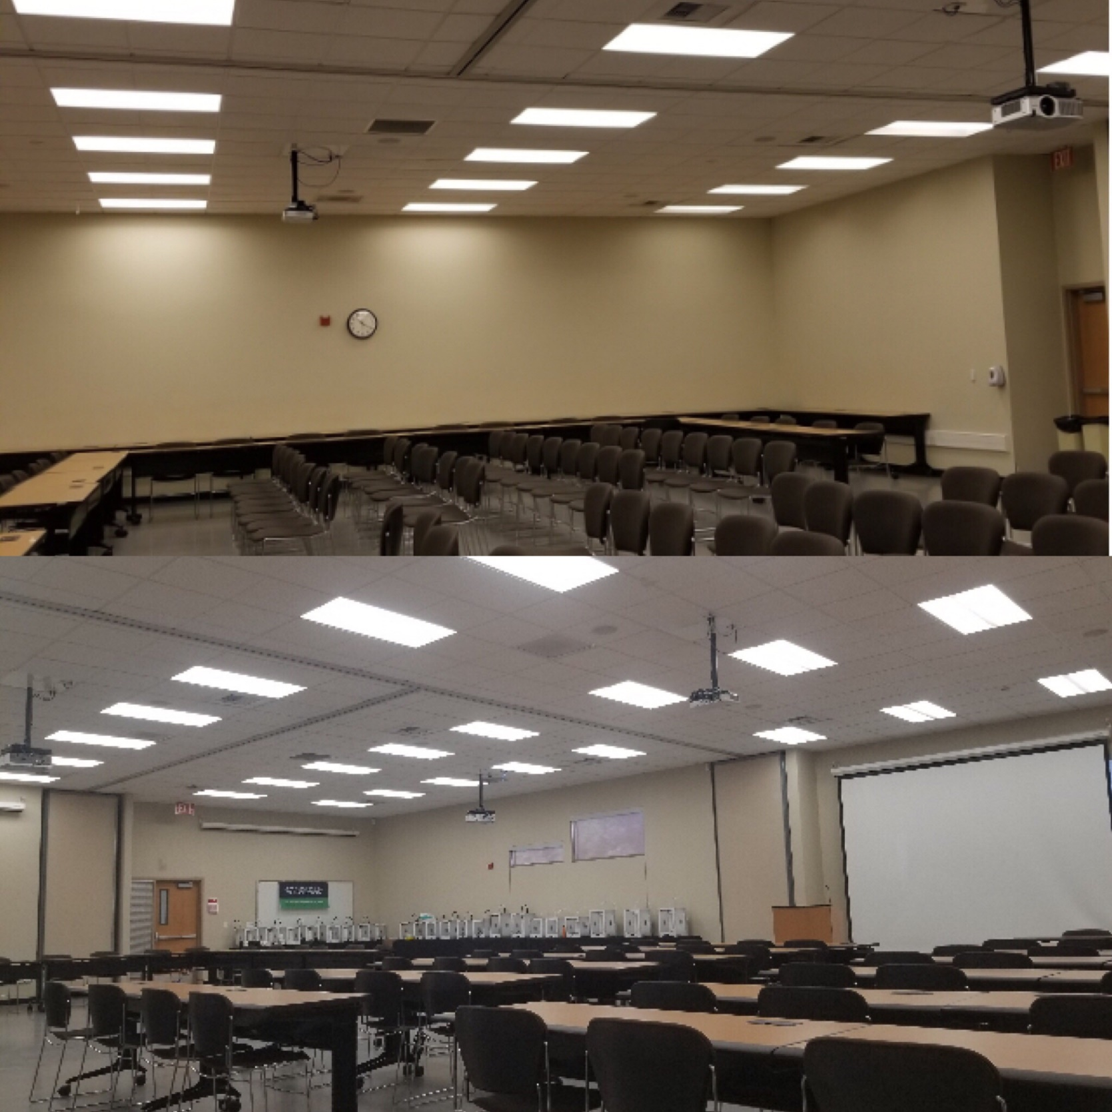
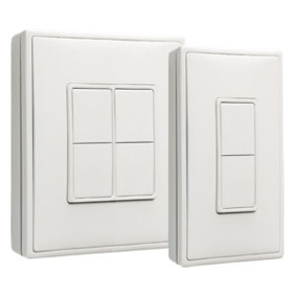
LED Lighting w/Wireless Controls
EnOcean Controls
Preinstalled at Factory
  Integrated to Sola Tube Dampeners
  Integrated to Lighting Harvesting Sensors
  Commissioning
Notes:
Mark and then he will introduce Tim with Three Peaks

Slide 25
3
IMPLEMENTATION OF ENOCEAN TECHNOLOGY AT THE SBCC DISTRICT OFFICES

Slide 26
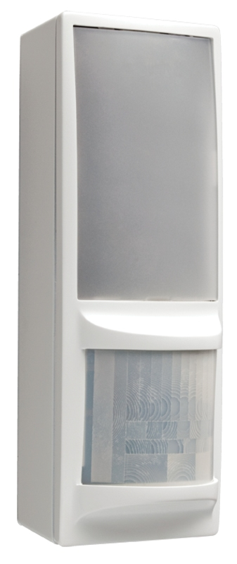
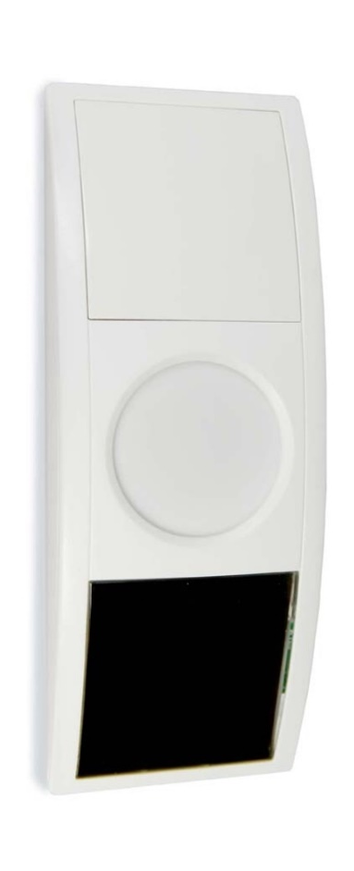
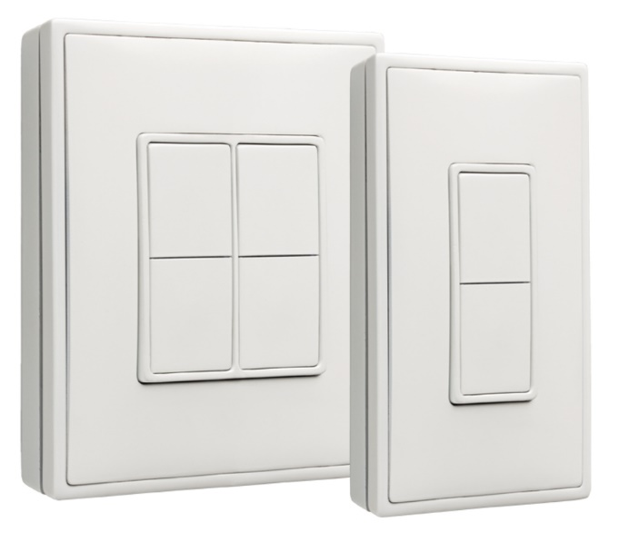
EnOcean Wireless Controls and Building Automation
EnOcean’s Energy
Harvesting wireless sensor technology
Combining miniaturized energy harvesters and ultra-low power wireless technology
Maintenance free sensor solutions for buildings, smart homes and industrial applications
Building Automation
Self powered wireless switches, sensors, and controls
Allows for building automation leading to reduced energy consumption and operating costs
Creates a more comfortable and secure building
902 MHz radio standard
Transmit wirelessly using an extremely small amount of energy
Up to 30 meters indoors with extremely high reliability
Notes:
Tim

Slide 27
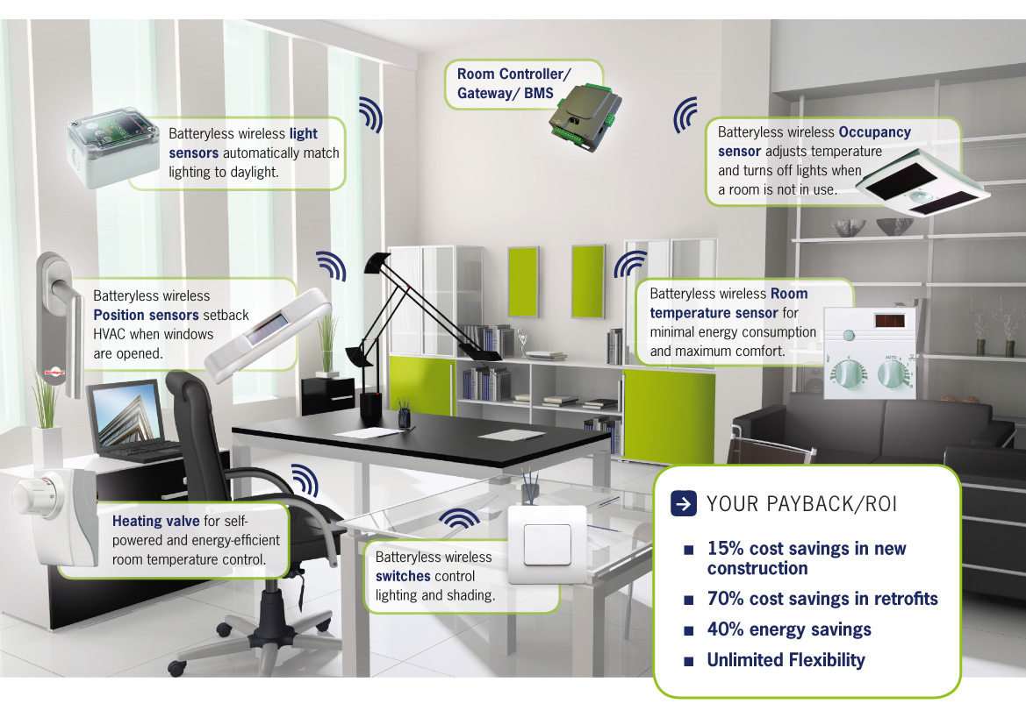
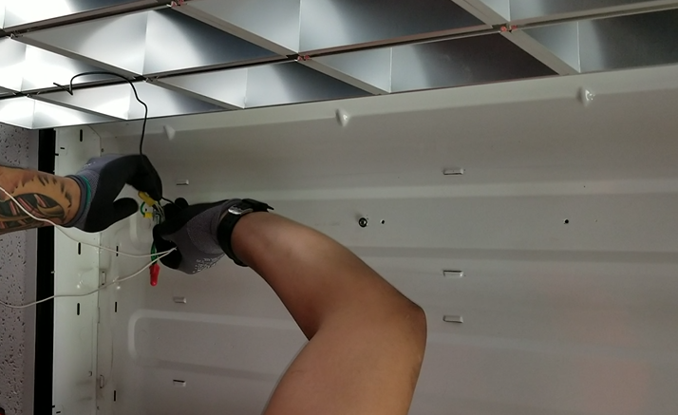
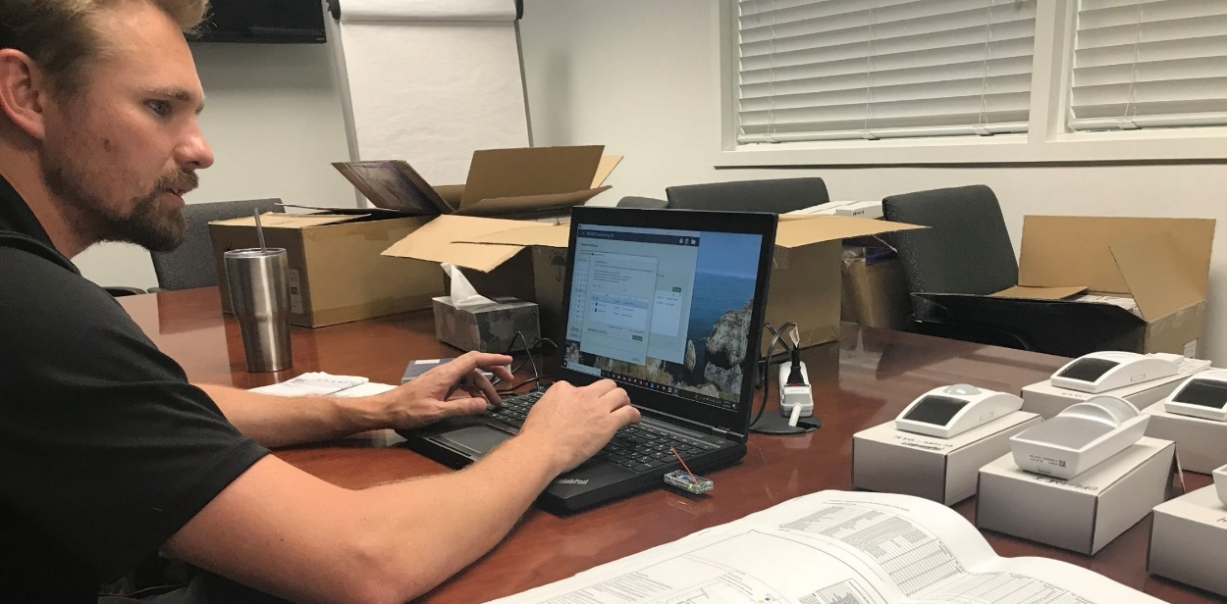
Retrofit and Commissioning Process
Installation of the new LED fixtures from LA Lighting with EnOcean relays
  Primary controller for each area.
Placement of the switches and sensors in designated area
Commissioning of the driver and sensors based on the needs of the space or area covered
Notes:
Tim

Slide 28
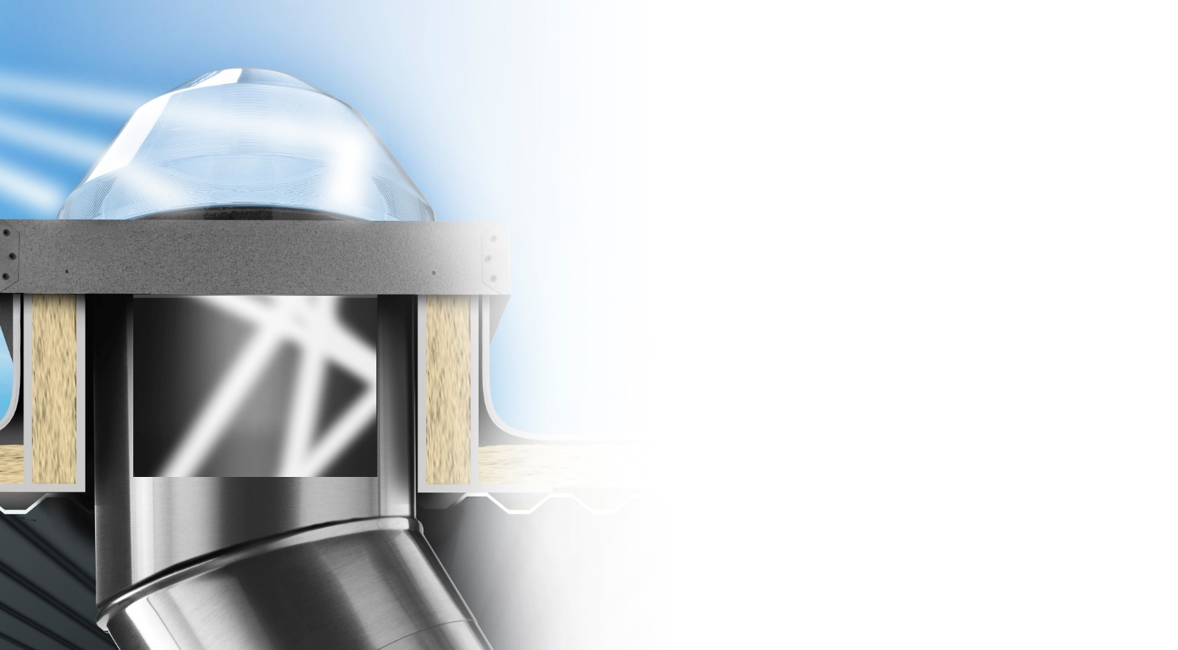








Transfer
Capture
Raybender® 3000
A patented daylight-capturing dome lens that redirects low-angle sunlight for maximum light capture.
LightTracker® Reflector
An innovative in-dome reflector that maximizes the capture of low-angle winter and late-day sunlight.
Spectralight® Infinity
Tubing that transfers maximum sunlight over long distances and up to 90 degree turns.
SoftLight™
Textured sections of
Spectralight Infinity tubing
and metal transition boxes
that diffuse and soften the daylight.
Deliver
Engineered Light Diffusion
Optical lenses and lighting control options that provide visual comfort and deliver superior diffusion.
Daylight Dimmer
0-10 low voltage dimer
adjusts daylight levels,
anywhere from full bright to
almost completely dark.

Slide 29
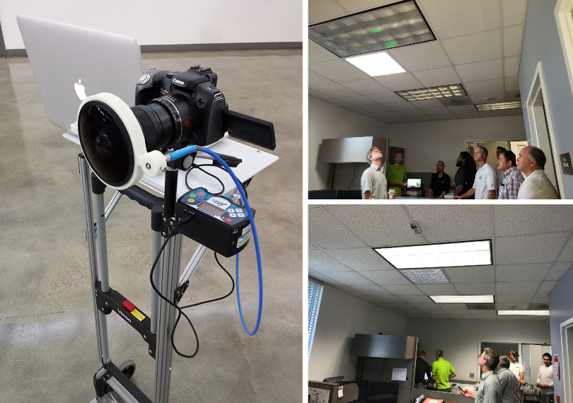
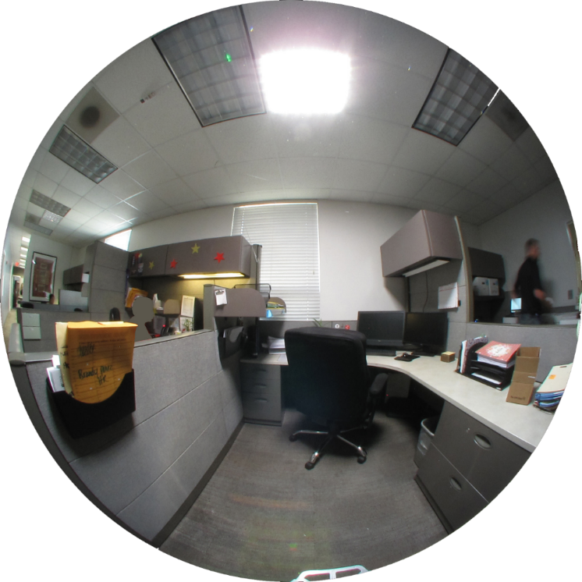
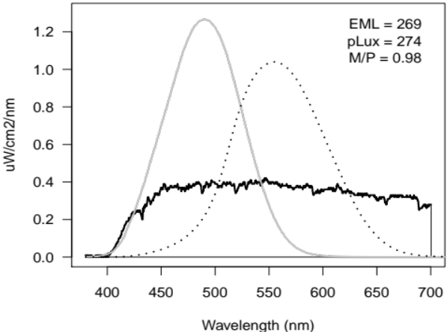
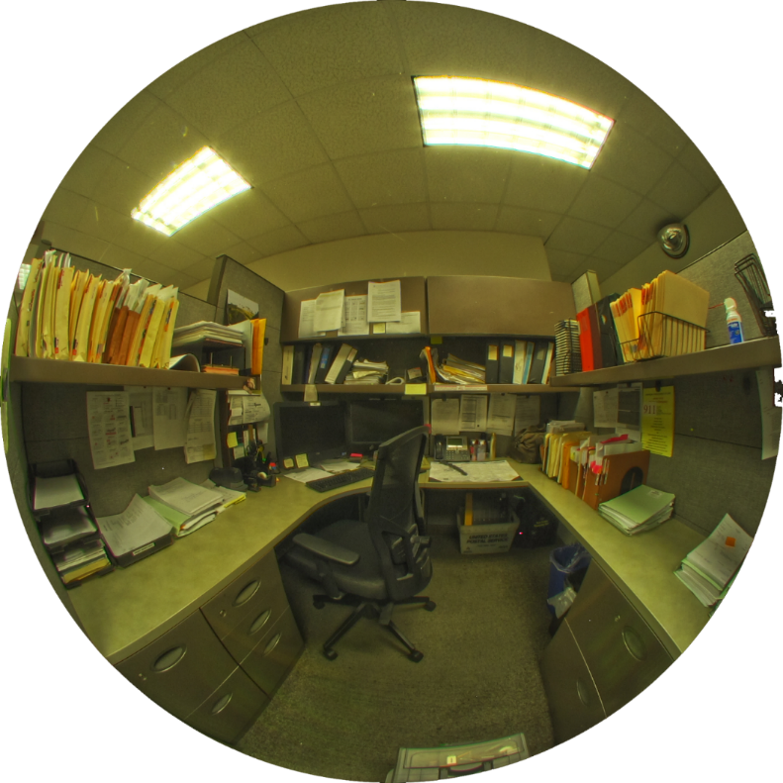
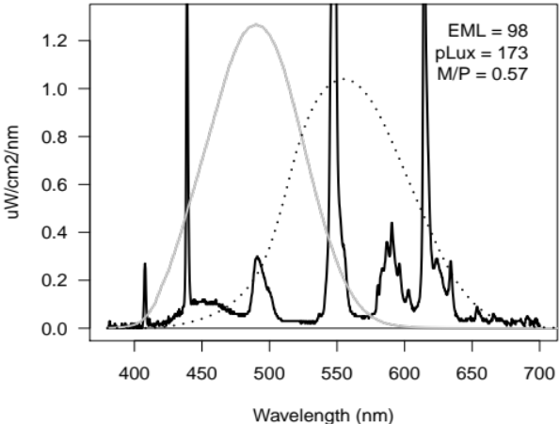
Spectrometer Spot Measurement
269 EML
Just SOLATUBE
98 EML
Old Fluorescent
Notes:
TIM
Few notes you can use: Now, let’s take a look at the Solatube (with the LEDs OFF) compared with the old fluorescent lighting condition
Note that this comparison is based on two spot measurements taken in different cubicles and slightly different view points. But the conditions are similar.
Just SolaTube
Where this measurement was taken, 269 EML is achieved with just the daylight coming from the SolaTube.
This measurement supports the design goal that workstations near Solatubes can be primarily lit with daylight during daylight hours, (even with the blinds fully closed).
Old Fluorescent
Compared with the old fluorescent light spectrum, which has sharp spikes, the daylight spectrum is broader and more even.
The daylight source delivers nearly three times more Equivalent Melanopic Lux (EML), which leads to greater potential for circadian stimulus and alertness

Slide 30
4
ONGOING OPERATION AND OCCUPANCY
Notes:
Tim

Slide 31
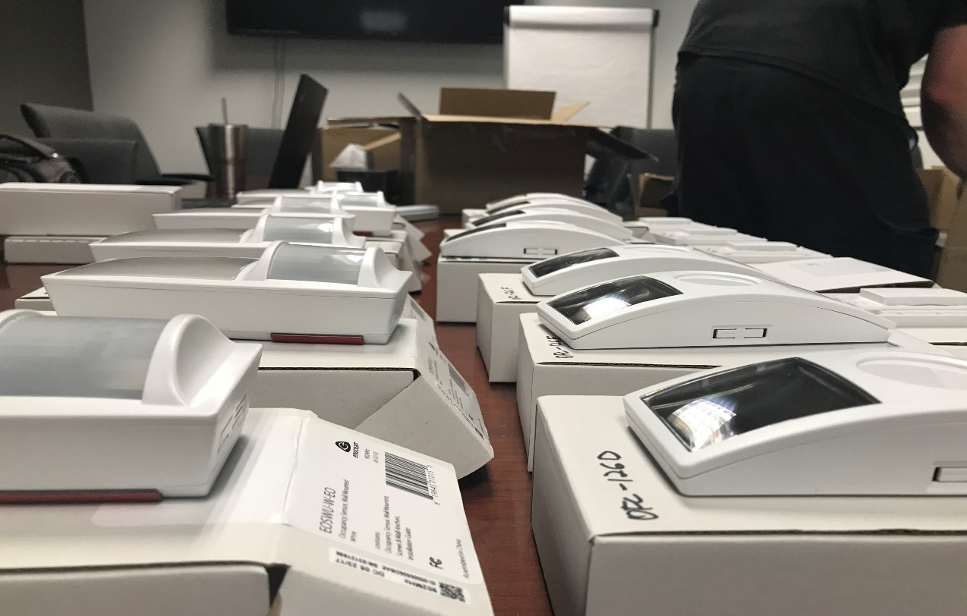
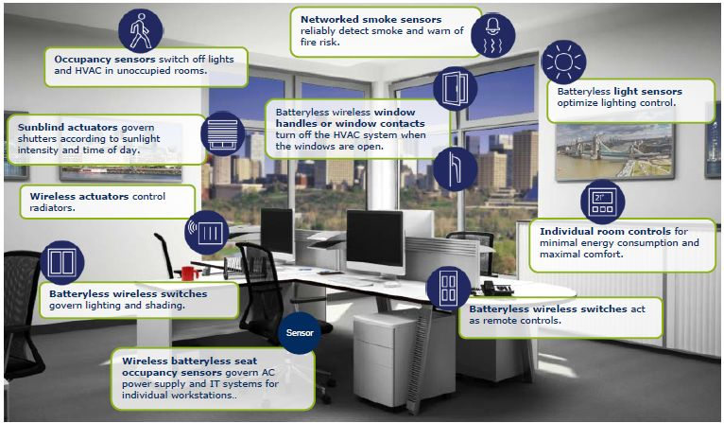
Occupancy
Ease of use
Automation for occupants and partial control
Interaction between LED’s, sensors, controls and Solatubes.
Occupants
Occupants in space vs designed intent
Adjustments
Pilot program vs Future Implementation
Current program allows for some control by occupants
Future programs will be completely automated
Notes:
Tim and Tim will introduce Bob with Sunbelt

Slide 32
5
SBCCD and Sunbelt Controls
Notes:
Bob

Slide 33
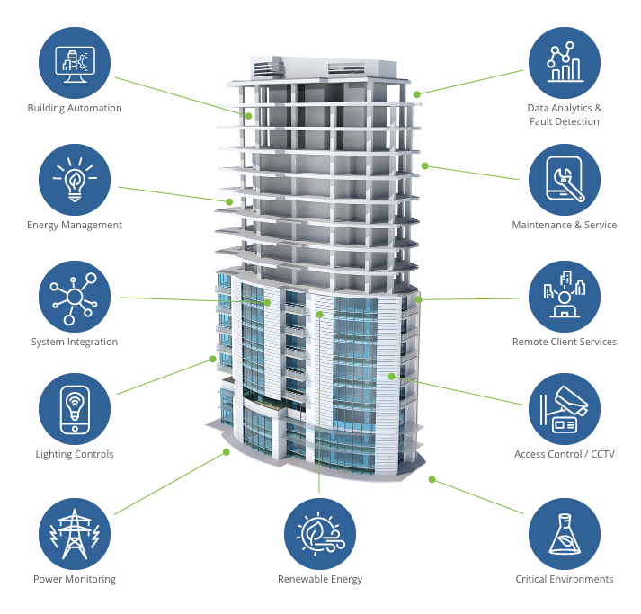

Sunbelt Controls
Leading full-service building automation contractor
  New construction and retrofit projects
Fully integrated, single source solutions ranging from
  Engineering applications
  Automated control systems
  Design assistance
  Sustainable maintenance service
  Retro-commissioning
  Energy rebate supported projects
Chosen to be an energy partner in helping with the controls design and sustainability of systems
Notes:
Bob
Sunbelt Controls is proud to be a valued partner with SBCCD
Sunbelt Controls is a design build contractor as well as a plan/spec contractor giving us the ability to create complete custom programming and sequences as required by SBCCD in their short and long term energy and comfort goals utilizing Automated Logic for its robust hardware, customizable programming and graphics and simple operators interface.

Slide 34
6
SBCCD’s Building Automation System.
Its Role in working toward a Zero Net Energy Goal.
Notes:
Bob

Slide 35
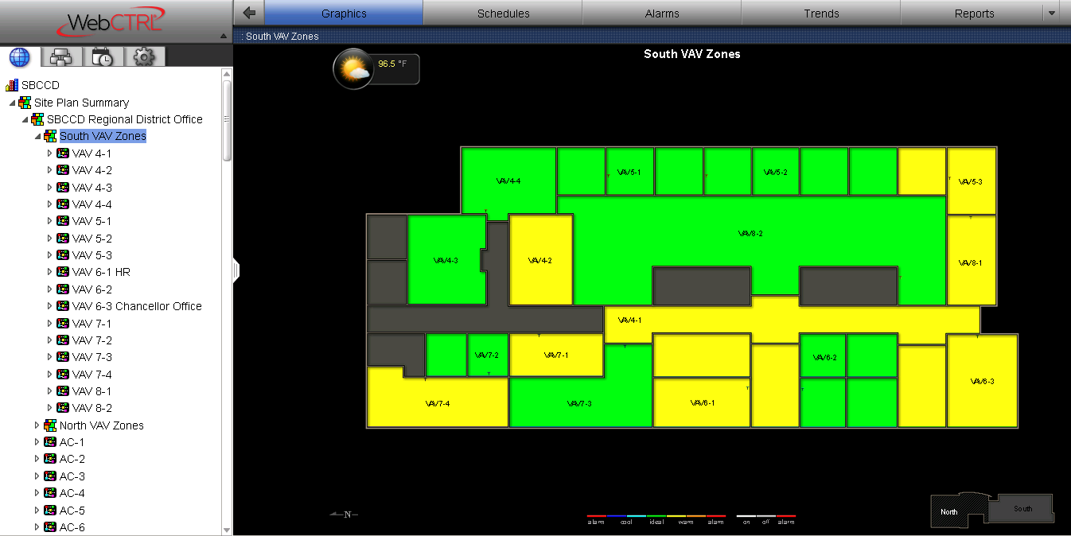


Energy Management Systems Basic Role:
Provide comfort to spaces without “overshooting” the space temperatures
Air Handler Unit operation to meet the space requirements without wasting BTU’s (Energy)
Maximize the use of schedules.
Notes:
Bob
As we know, a proper conditioned space optimizes efficiency and moral of staff.
Goal is to get the spaces to the desired setpoint of the room sensor without overshooting the setpoint causing a waste of energy
The Programming on the AHU utilizes the economizer to its maximum capability, then when mechanical cooling / heating is required, the unit tries to satisfy the areas it serves as quickly as possible to get the unit into ventilation mode, the most efficient mode for a multi space AHU
Scheduling the system is a key to any buildings success. The flexibility with the schedules that SBCCD required us to implement coincides with their complex control strategies. Whether its is a Building, Group, Individual space, multi segmented day to day scheduling, these are all contributing factors to the energy goal set forth by the district.

Slide 36
7
Energy Saving Strategies
Notes:
Bob

Slide 37


SBCCD Designed Sequence
The control sequence is heavily based on:
CO2 monitoring
Motion Detection in the space
Relaxing of temperature setpoints when space is unoccupied
Safety First…
CO2 Levels shall always prevail on indoor air quality in any current operating mode
Indoor Air Quality
Minimal air changes to unoccupied spaces to keep space from being stale
Quicker recovery times when space goes occupied
Notes:
Bob
This is only one of the ground breaking strategies that the SBCCD design team came up with this sequence that was requested to create programming to meet and implement into the spaces that are single unit, like classrooms.
As we know, classrooms are NOT always occupied during normal school hours. So, this sequence is instrumental in load shedding and savings in unoccupied spaces.
Design criteria was:
Unit off when space is unoccupied completely
Unit off when space is scheduled, and no motion is detected in space
Unit on only when schedule AND occupancy are both active
High levels of CO2 will always bring unit on in any operating mode.

Slide 38





Q&A

