Slide 1
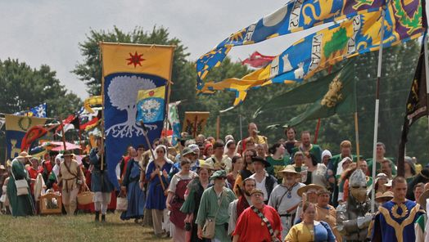

A Report of The Society for Creative Anachronism In 2019
John Robinson
English 101 Report
Professor Ramos

Slide 2
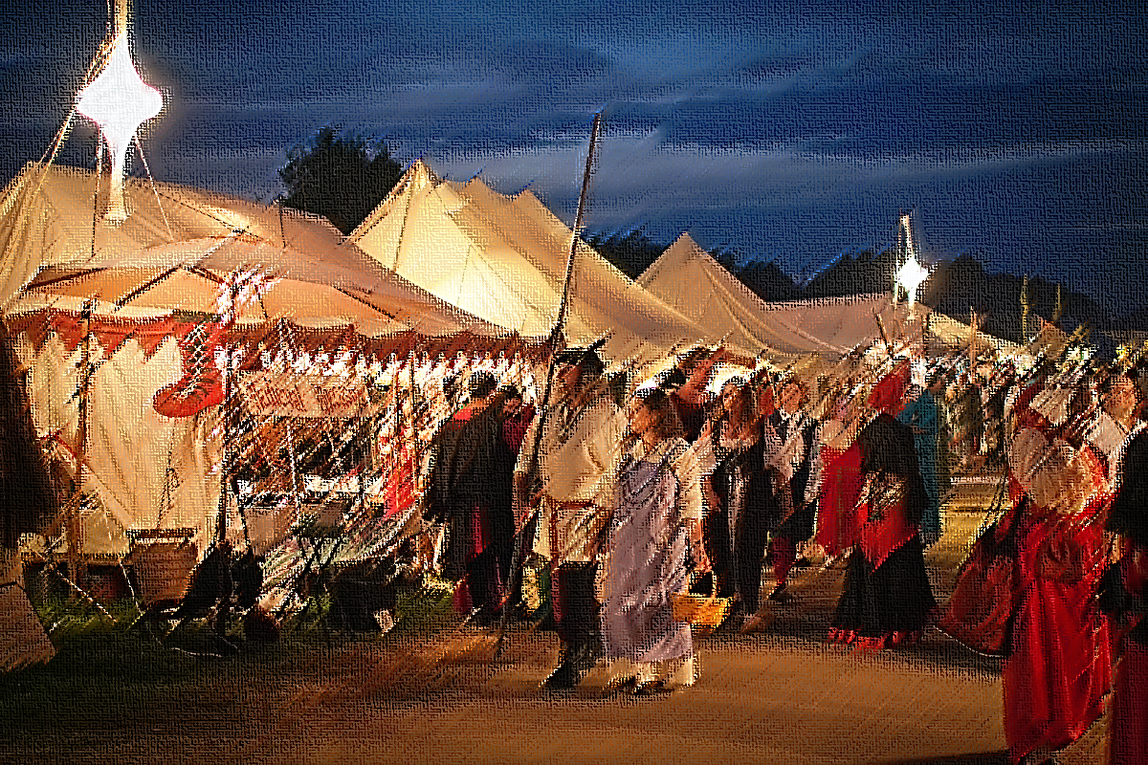
What is the Society for
Creative Anachronism?
The Society for Creative Anachronism (SCA) is an international non-profit volunteer educational organization. The SCA is devoted to the research and re-creation of pre-seventeenth century skills, arts, combat, culture, and employing knowledge of history to enrich the lives of participants through events, demonstrations, and other educational presentations and activities.

Slide 3
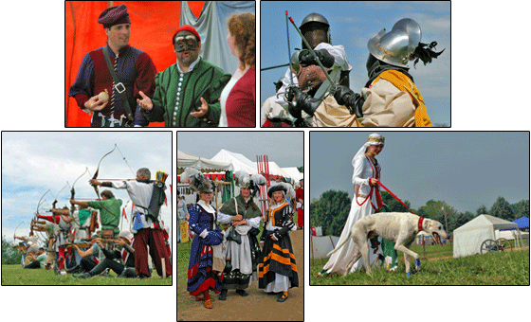
Activities in the SCA
Arts and Sciences
Combat and Chivalry
Youth combat
Persona and Camp Life
Heraldry

Slide 4
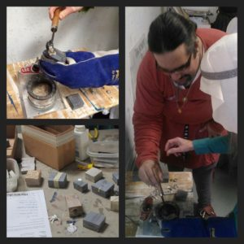
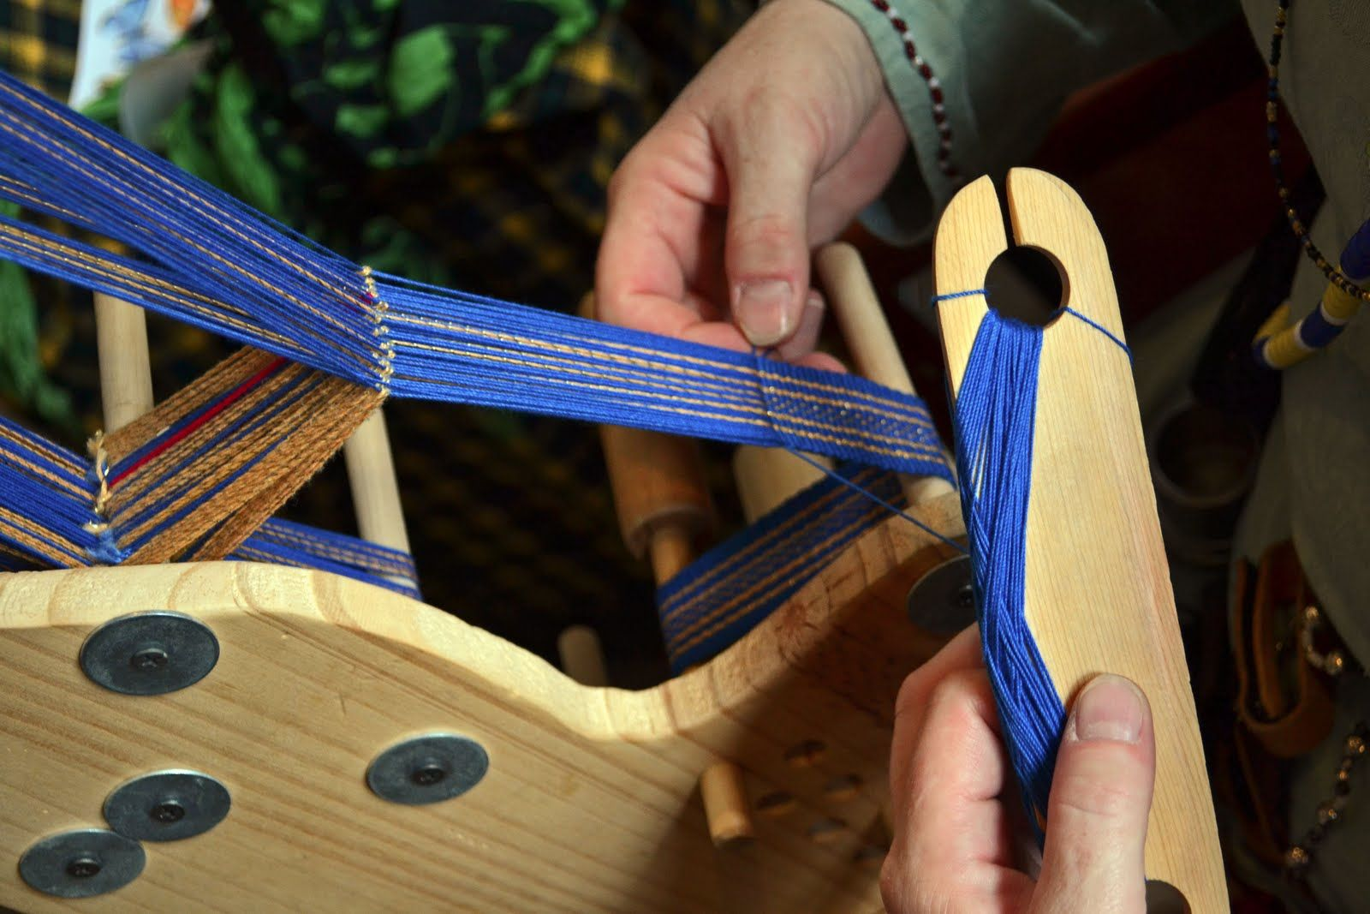
Art and Sciences in the SCA
Armor and Weapons Craft, Tapestry making, and Bards!
The SCA teaches the old ways blacksmithing, tapestry making, and playing now is music you would hear from Bards.

Slide 5
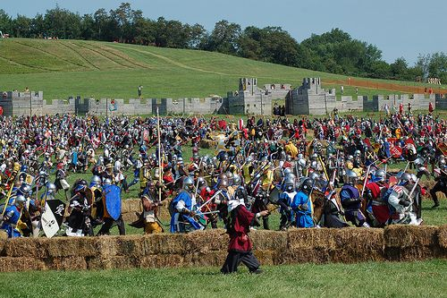
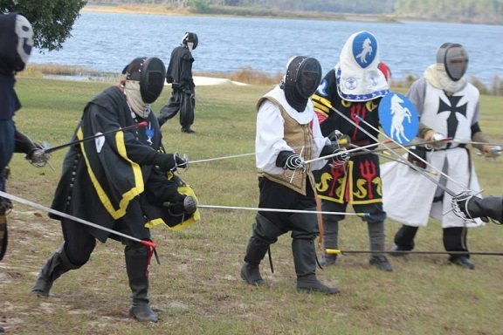
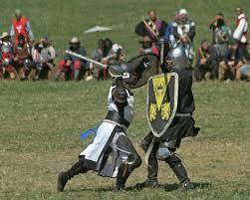
Combat and Chivalry
Armored Combat
Dueling
Chivalry
Armored combat is a scenario-based combat experience that involves every aspect of combat from archers, shield man, spearman, archers, and siege weapons.
Dueling is a one on one combat the uses the rapier for it main weapon and allows for formal use to simulate the early duels.
Chivalry is a one on one open combat style. Any weapon combination can be used in these fights the most common are a sword and shield.

Slide 6
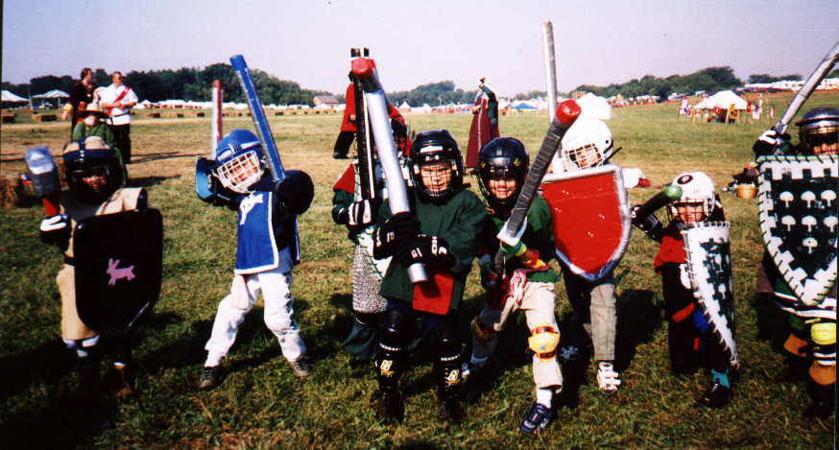
Youth Combat
According to the SCA's Youth Combat program, “Children from ages 6 through 17 have the opportunity to participate in a kid-friendly and safe version of adult comtbat. The program emphasizes courtesy, honor, and service as well as skill and safety. Boys and girls participate together, separated only by age, not gender.”

Slide 7
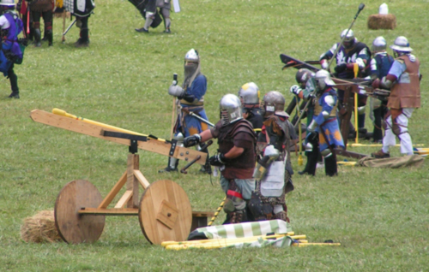
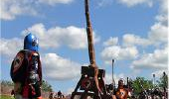
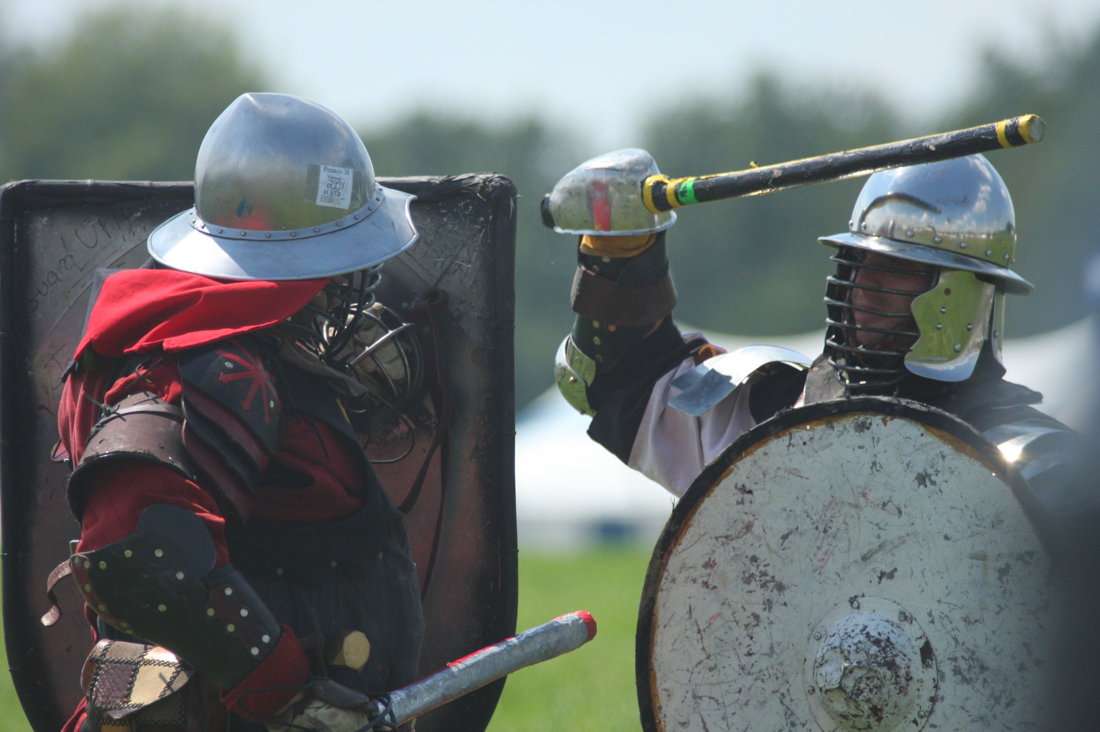
Tools and weapons of war.
Ballista
Trebuchet
Sword and Shield
This is an important siege weapon in armored combat. An excellent shield wall breaker.
Ballista arrows are heavily padded to reduce the impact force.
A long range anti calvary and excellent castle wall destroyer.
The trebuchet launches colored powder inside of balloons to mark its targets.
Made out of rattan and plastic all swords and shield used in armored combat are blunt and padded to prevent injury

Slide 8
Armored Combat Can Be Unsafe and Dangerous!
All official combat takes place under the watch of well-trained and experienced officials known as “Marshals”. Equipment standards are strictly adhered to, and chivalry reigns supreme. Combatants engage in battle, on their honor, calling blows and graciously thanking their opponents for the opportunity
- Barony of Wintermist
According to the Barony of Wintermist, a part of the SCA located in California, Yes armored combat can be dangerous.
What’s the solution to this?
Rules
and
regulations!

Slide 9
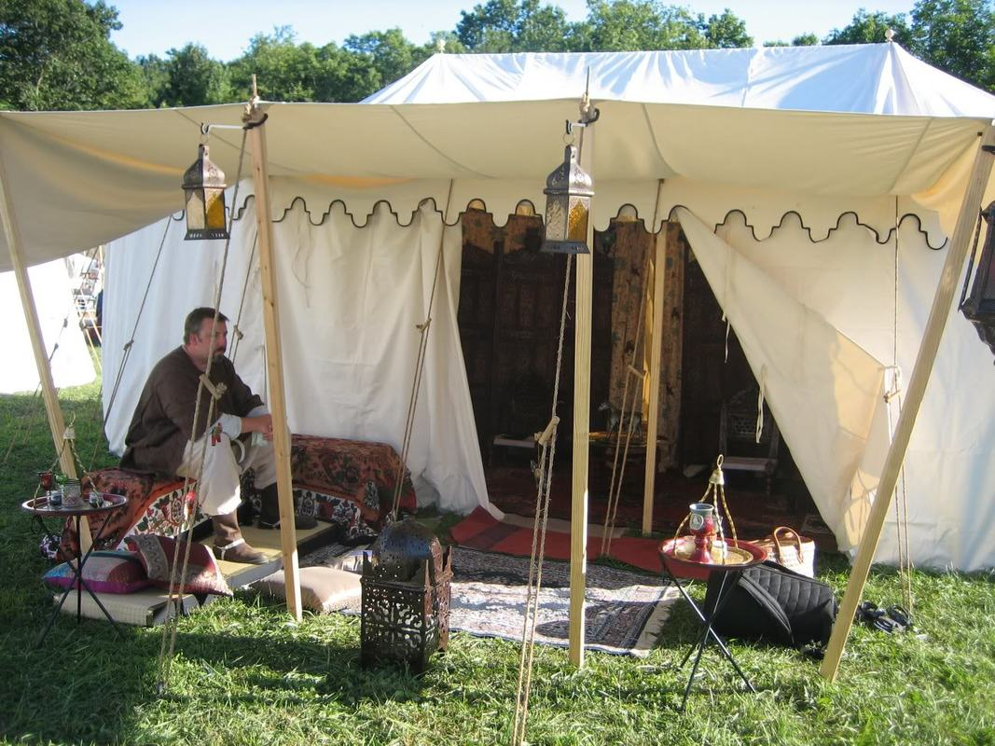
Personas and Camp Life
Persona
SCA The Dream
An individual must pick and live by their historical persona. Vikings, Englishman, early Italy, and even samurai are common persona choices
Here Is a short video displaying what persona, camplife, and combat are like.
SCA The Dream

Slide 10
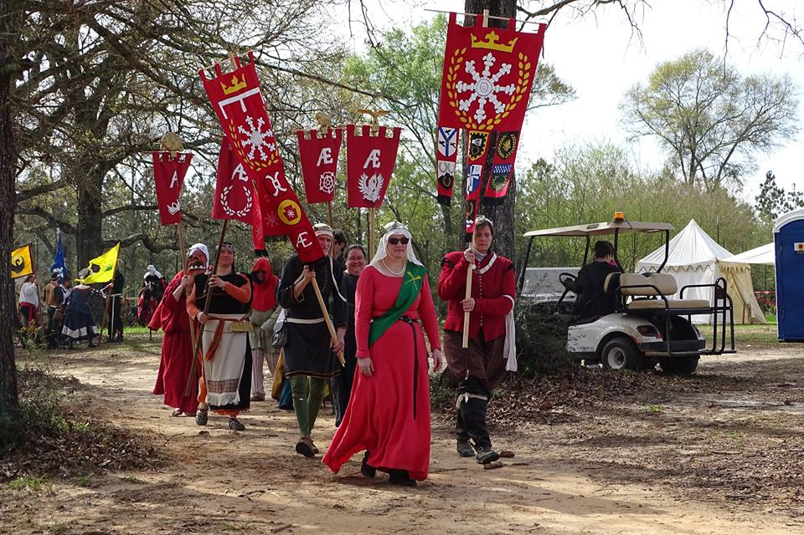
Heraldry
Heraldry are the celebrations and ceremonies that are held. Knighting crown ceremonies, and combat tournaments victories are common Heraldries.
Brandon Olson, the Deputy Shenshial is a representative from the Kingdom of Caid who is responsible for setting up the combat heraldries.

Slide 11
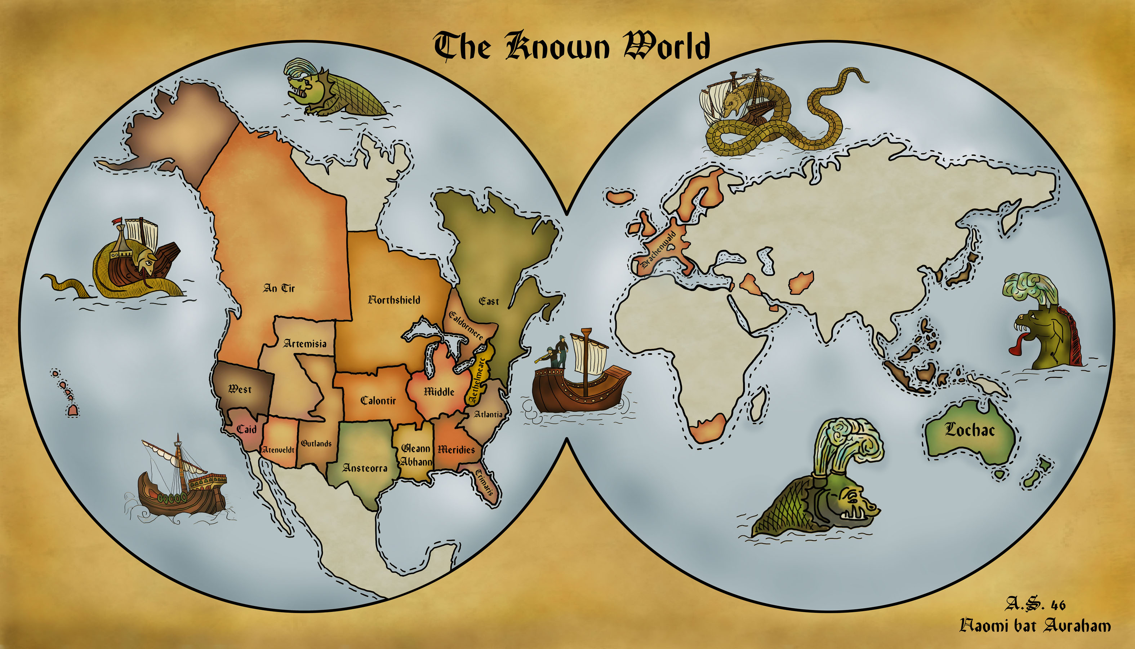
The SCA is split up into kingdoms around the world. The area of San Bernardino is located in the kingdom of Caid.

Slide 12
Importance of the SCA
The Society for Creative Anachronism strives to not only preserve but also come as close to living our history as we humanly can.
NBC News does an amazing job at getting inside the combat and lifestyle in the sca in this video. NBC SCA

Slide 13
Works Cited
Designs, Zanshin. “Society for Creative Anachronism, Inc.” Society for Creative Anachronism, Inc., https://www.sca.org/.
“Is Armored Combat Dangerous?” The Barony of Wintermist, 19 Sept. 2015, https://www.sca-wintermist.org/is-armored-combat-dangerous/
Personal Interview, Brandon Olson Deputy Shensial of Caid 2019
Personal Interview, Ricky Myers Mercenary in the Kingdom of Aethelmearc.
“SCA The Dream.” YouTube, Sca, https://youtu.be/yCyu7rveBXs.
The Witcher 3, CD Projekt, 2015
“We Three Celtic Kings by Alexander Nakarada: Royalty-Free Music Promoted by Free-Stock-Music.com.” Stock, https://www.free-stock-music.com/alexander-nakarada-we-three-celtic-kings.html
https://www.silvermansound.com/free-music/the-medieval-banquet
YouTube, NBC News, https://youtu.be/uonpDjbC4aE.

